Slide 1
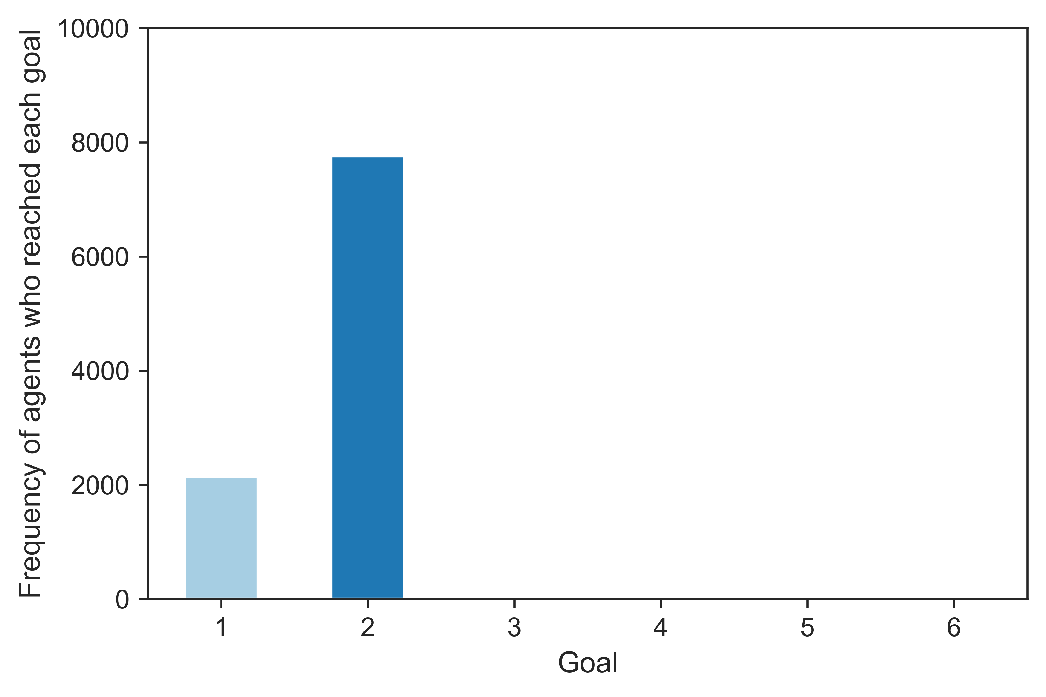
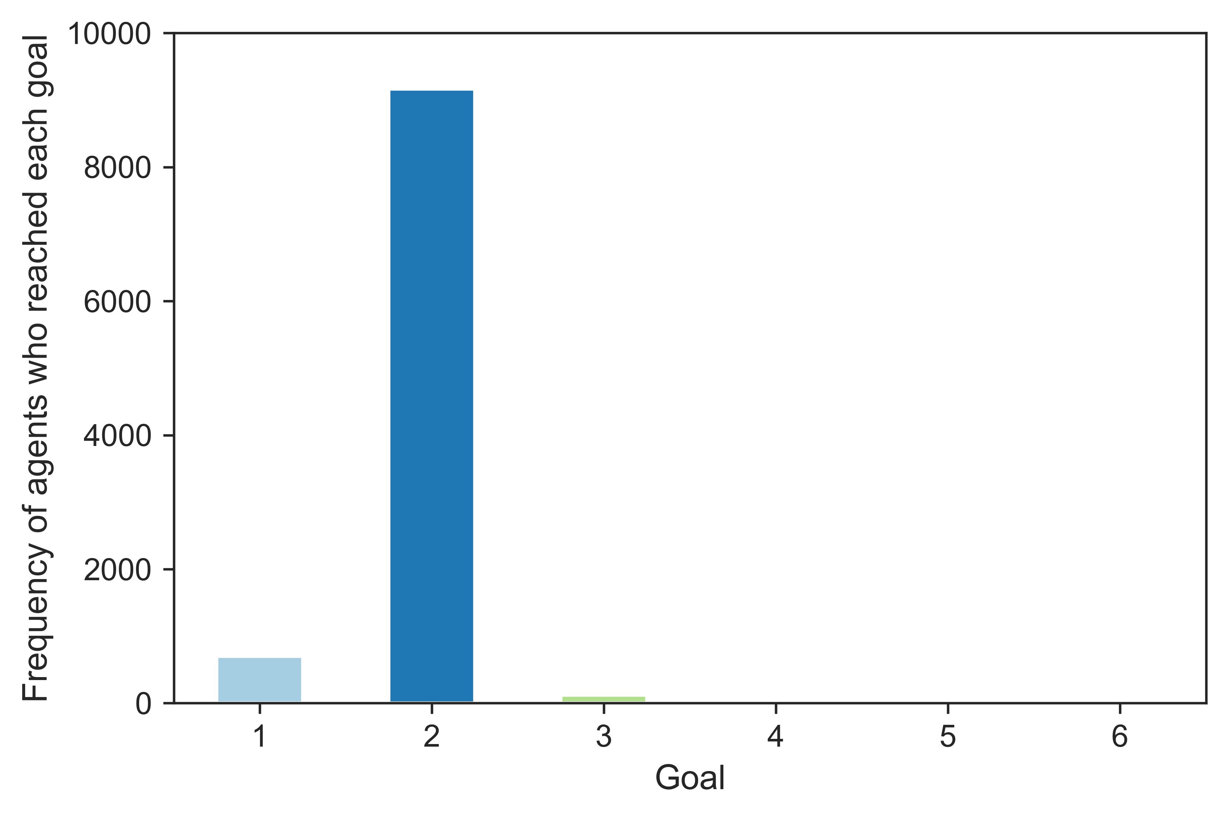
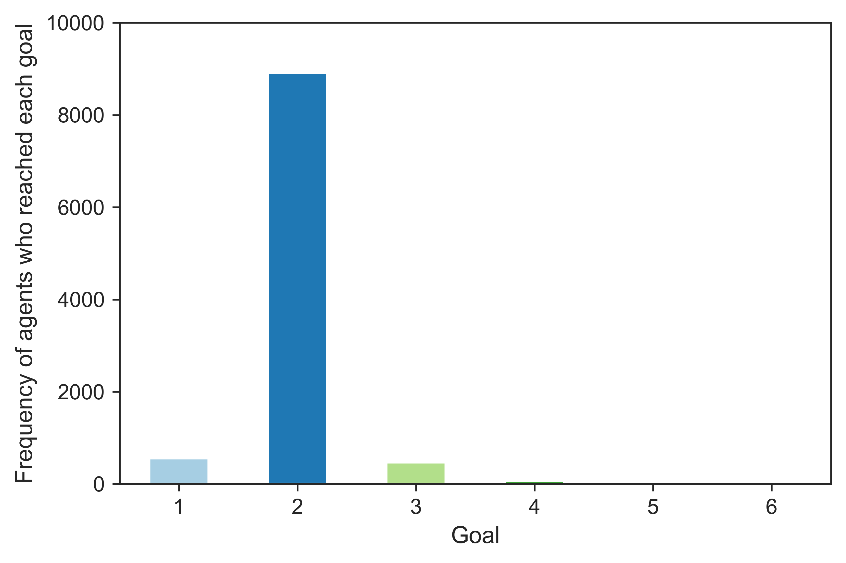
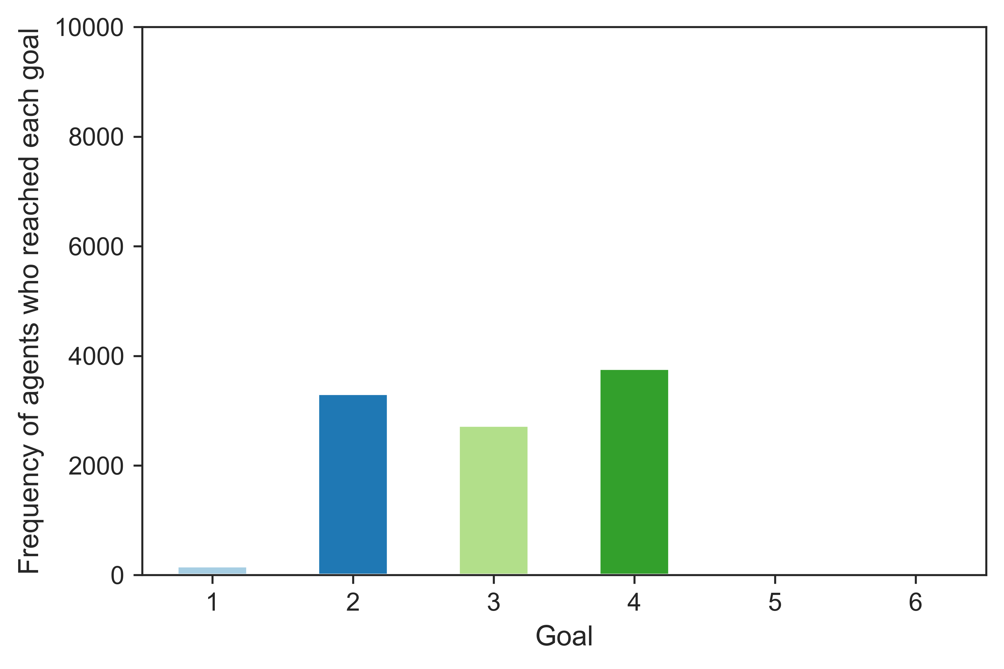
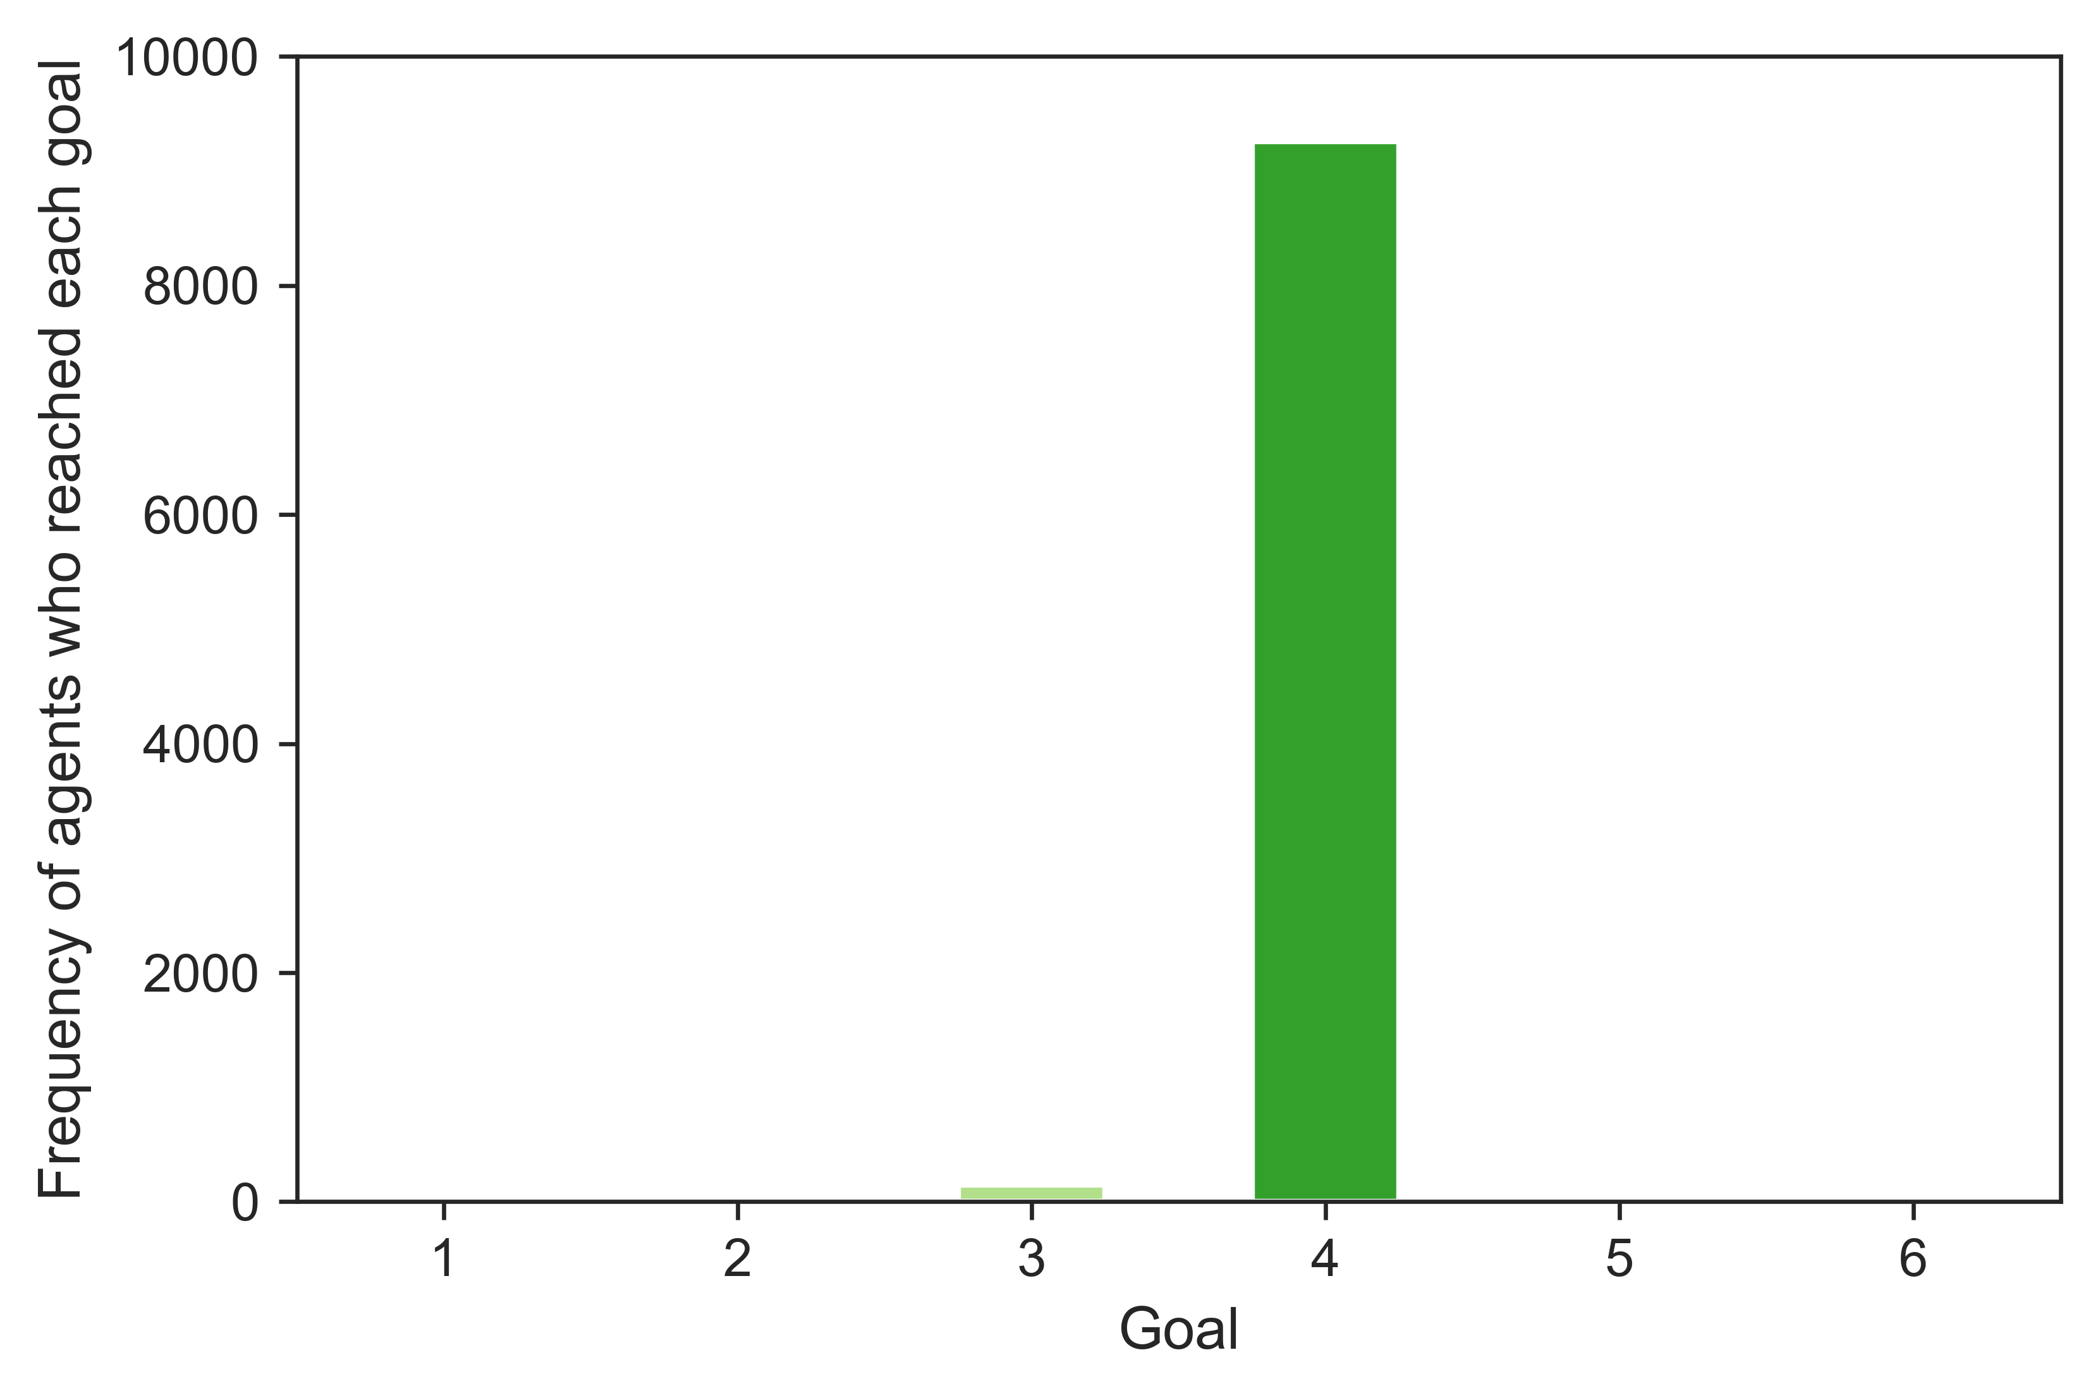
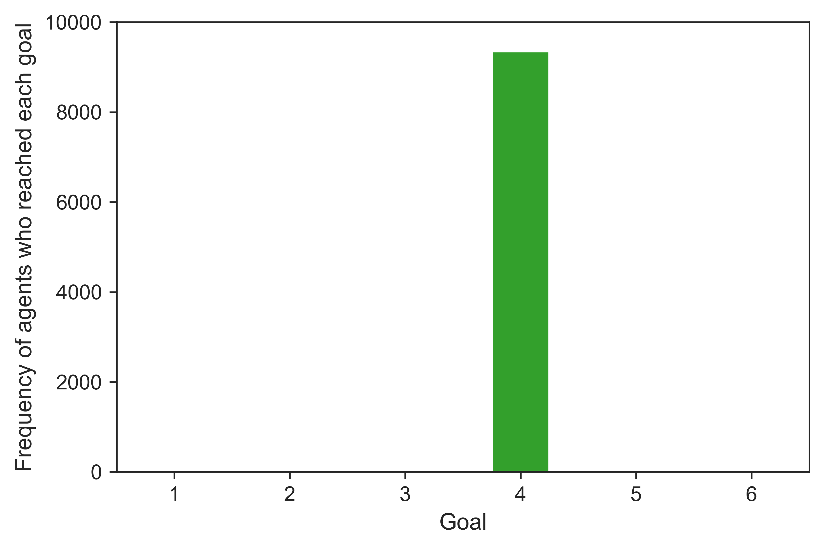
A (10th round)
B (100th round)
C (400th round)
D (5000th round)
E (20000th round)
D (40000th round)

Slide 2
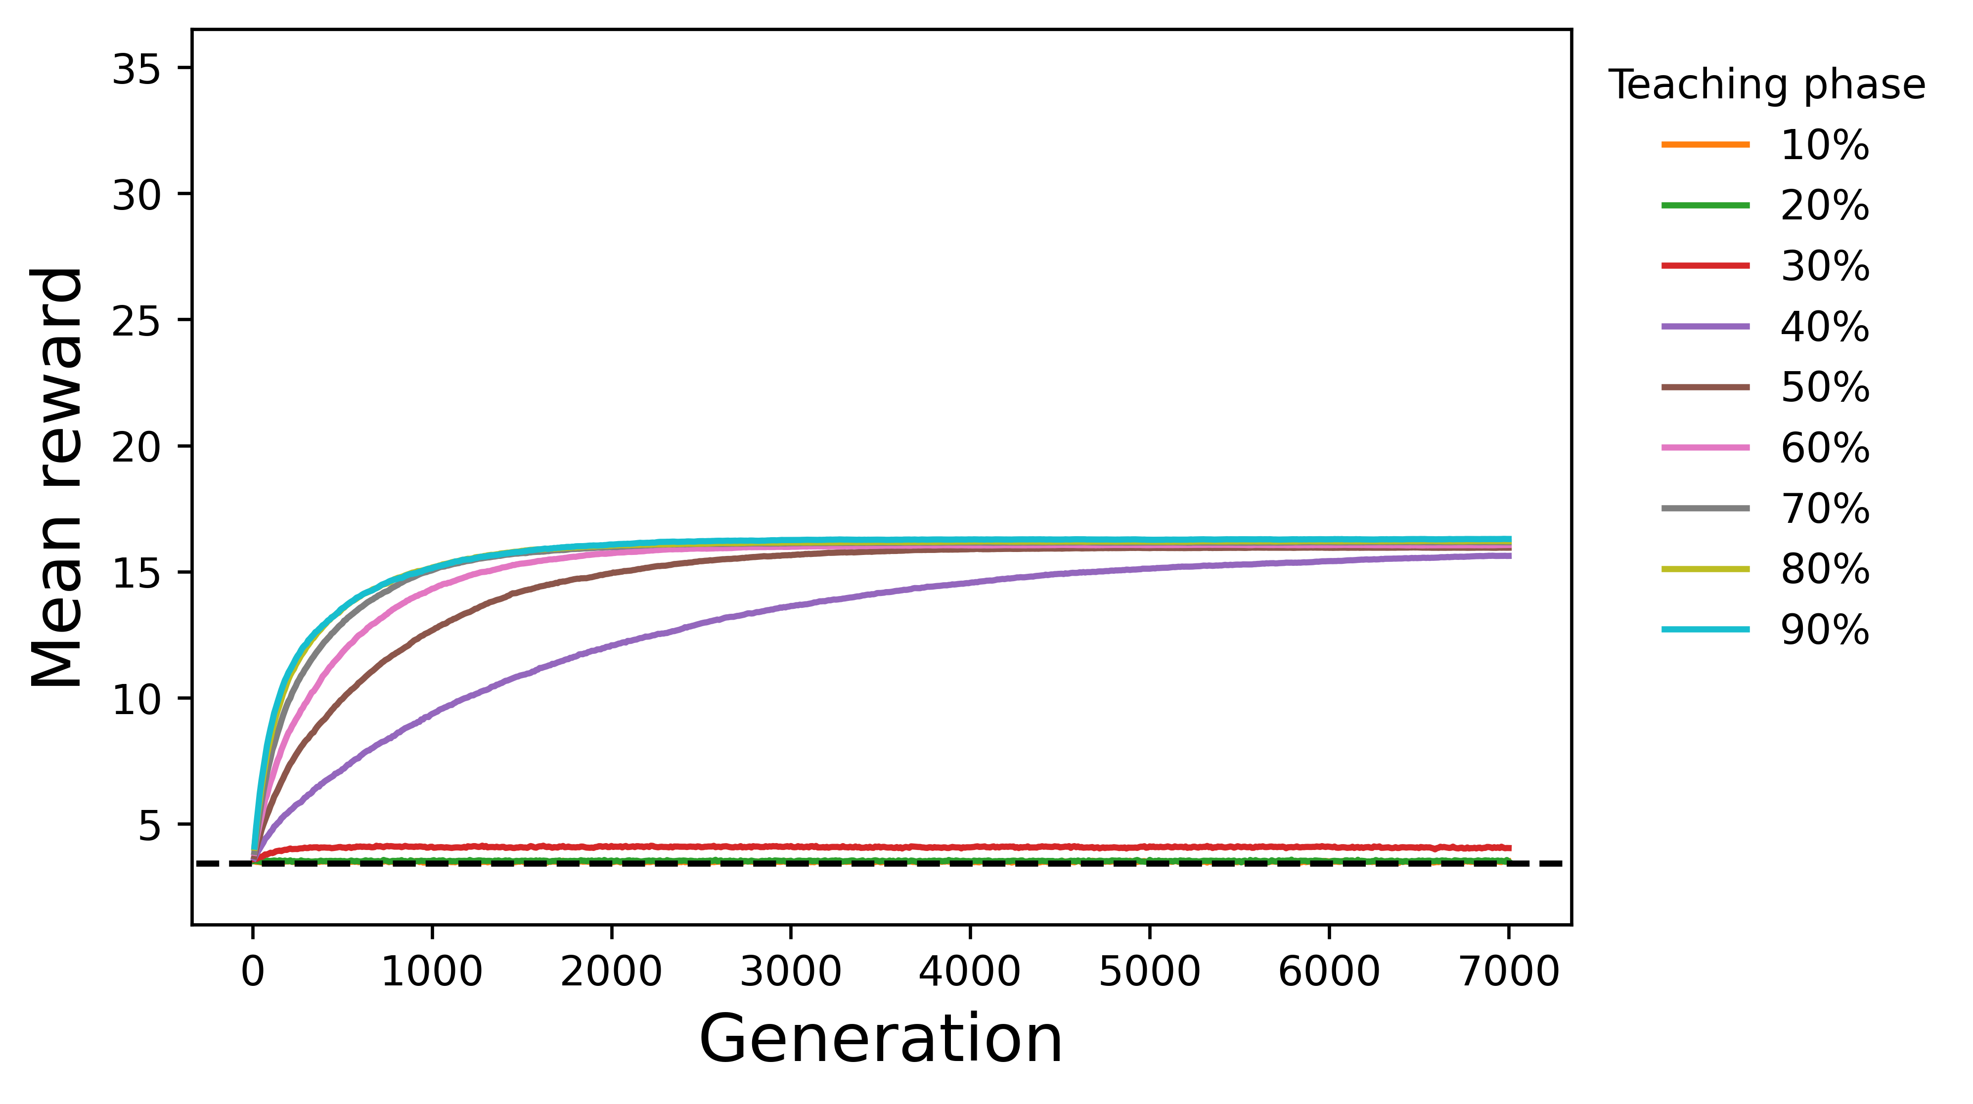
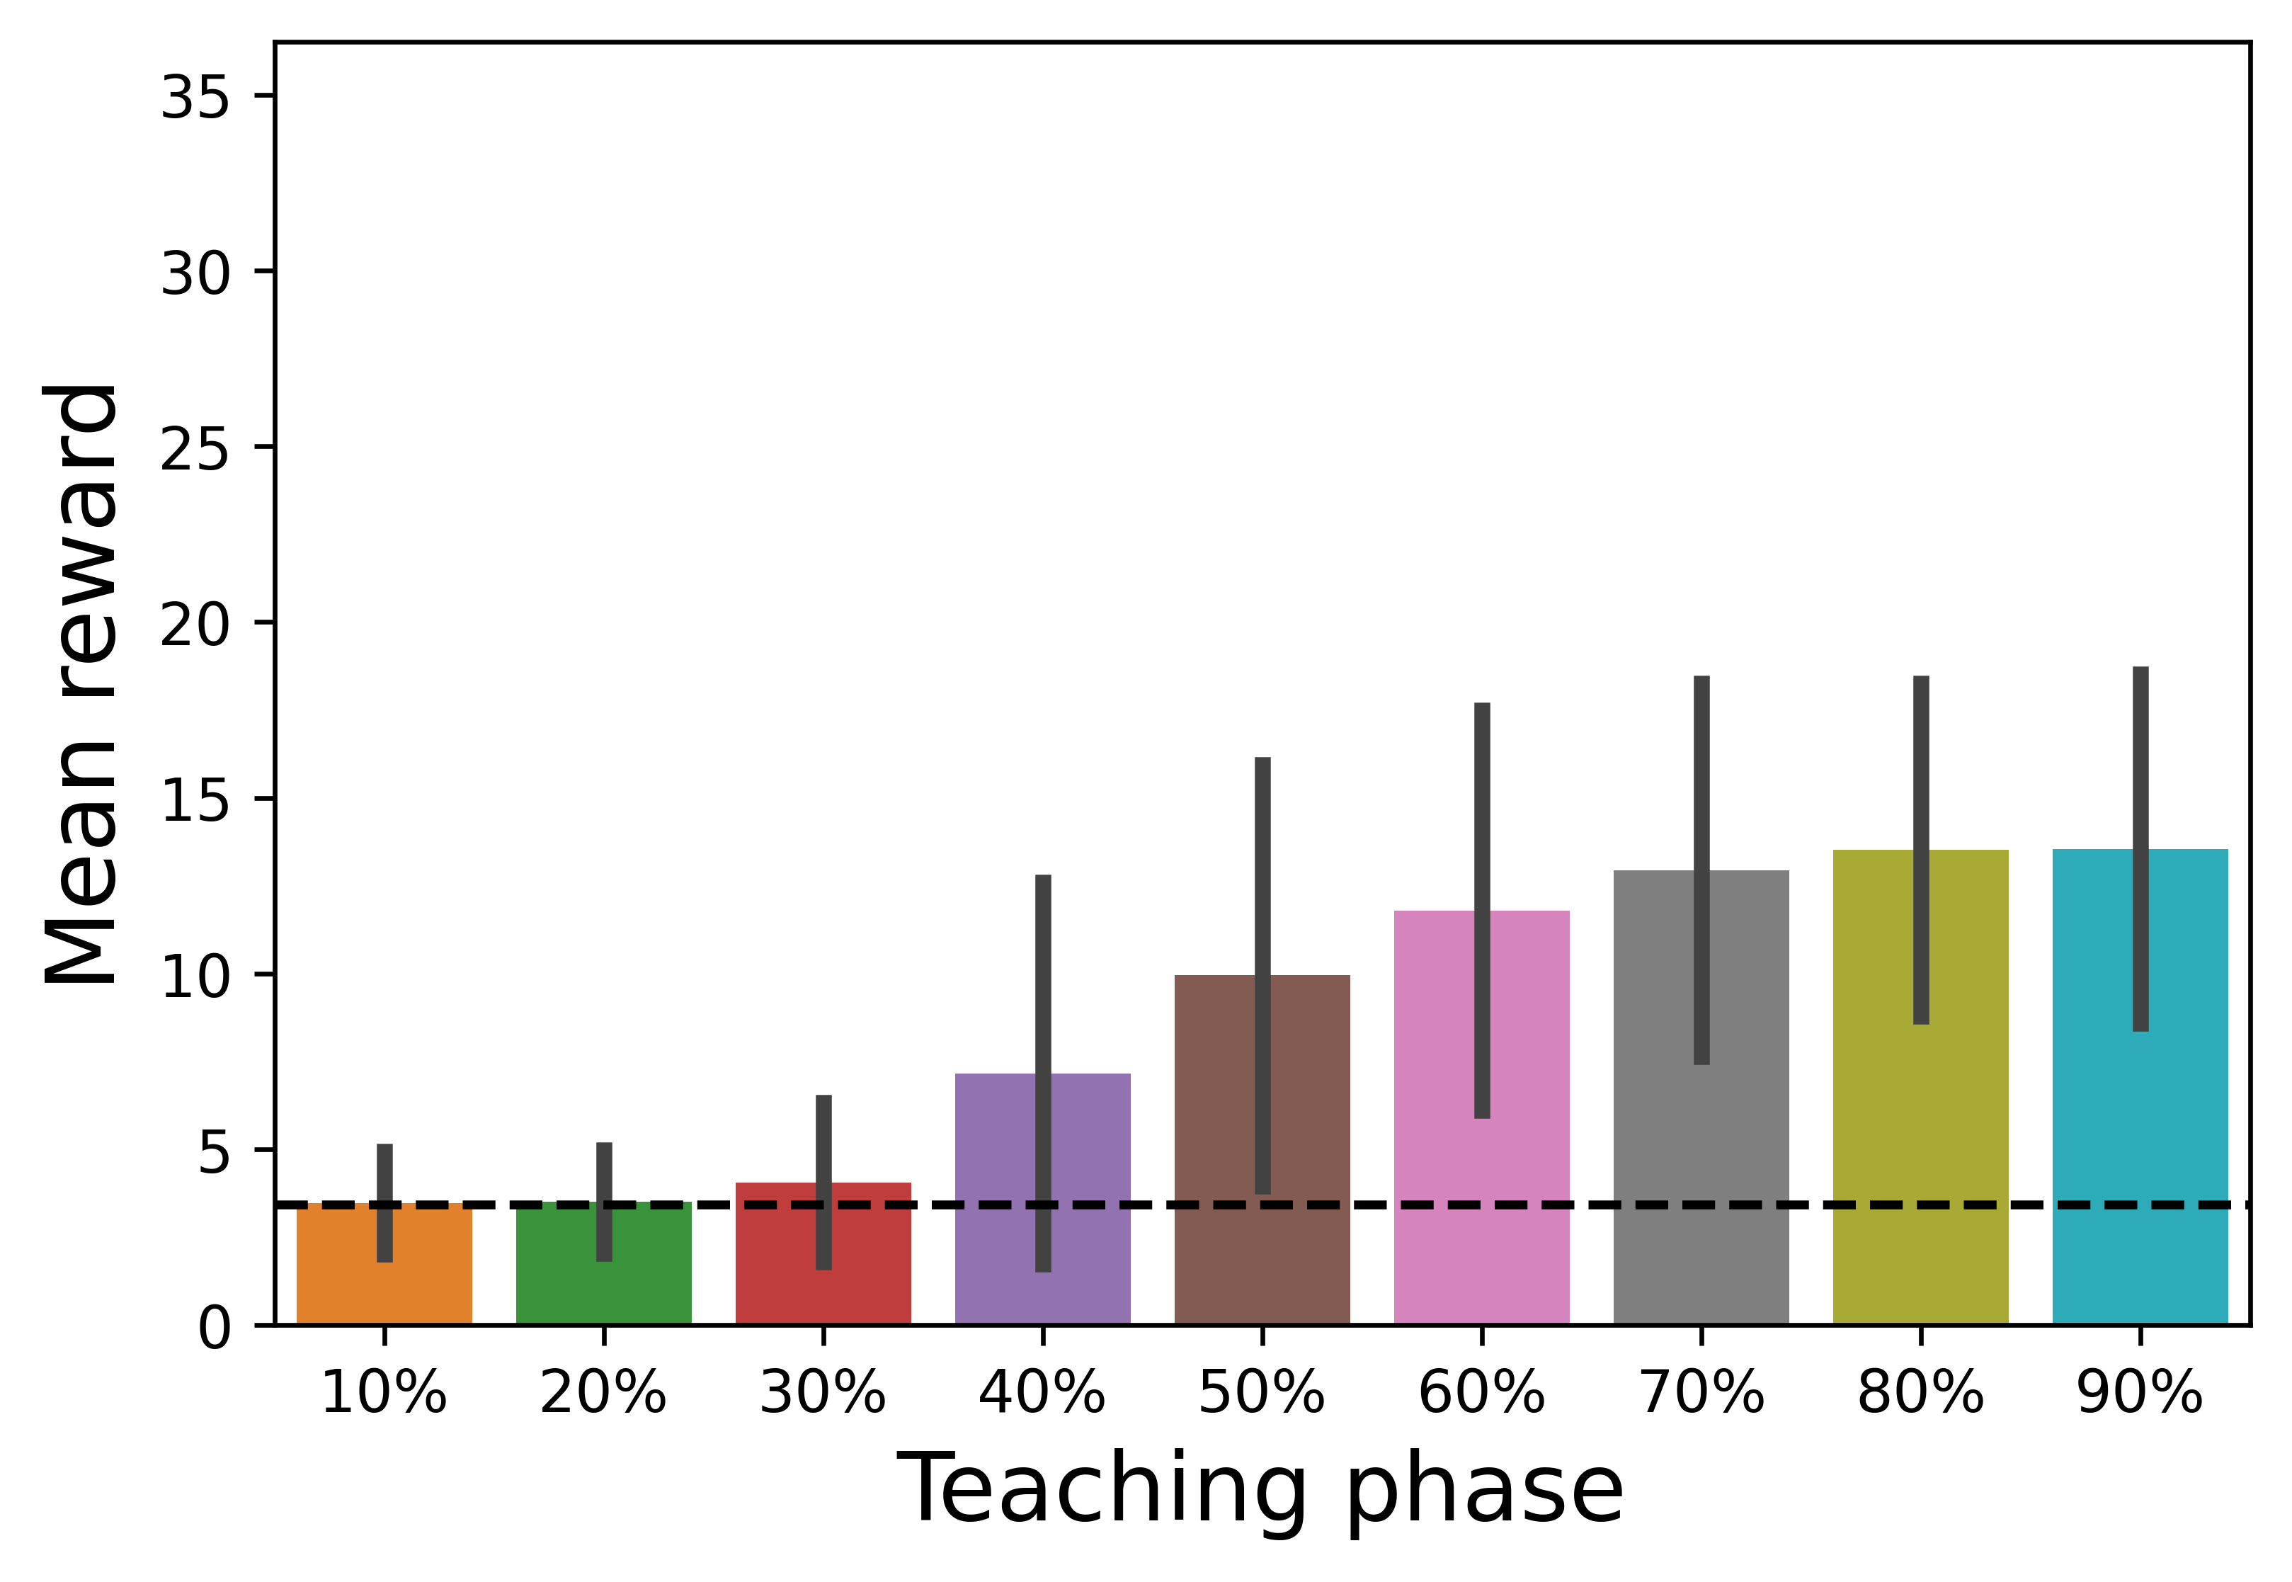
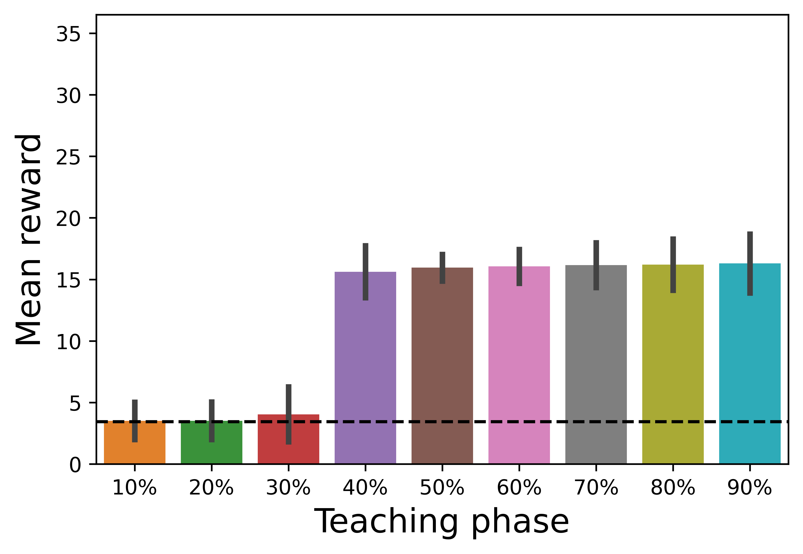
A (R = 10)
B (R = 10, 500th Generation)
C (R = 10, 7000th Generation)

Slide 3
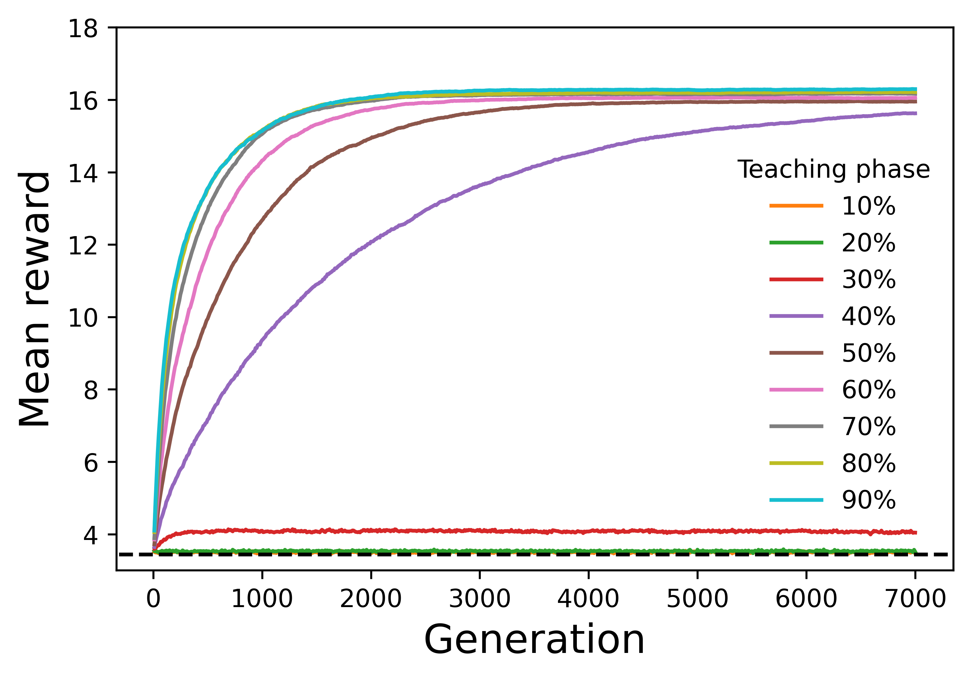
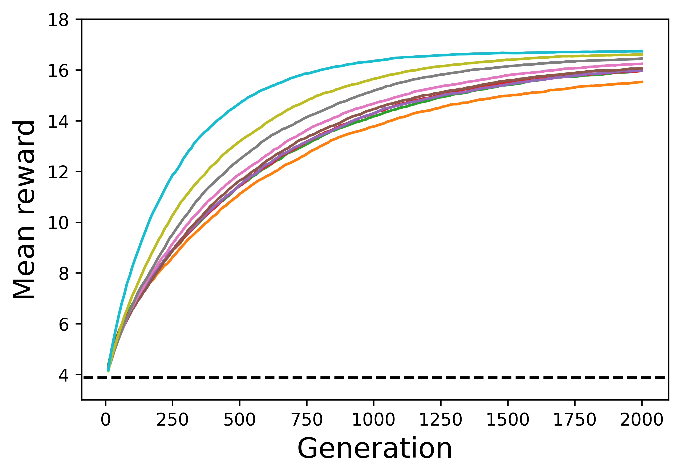
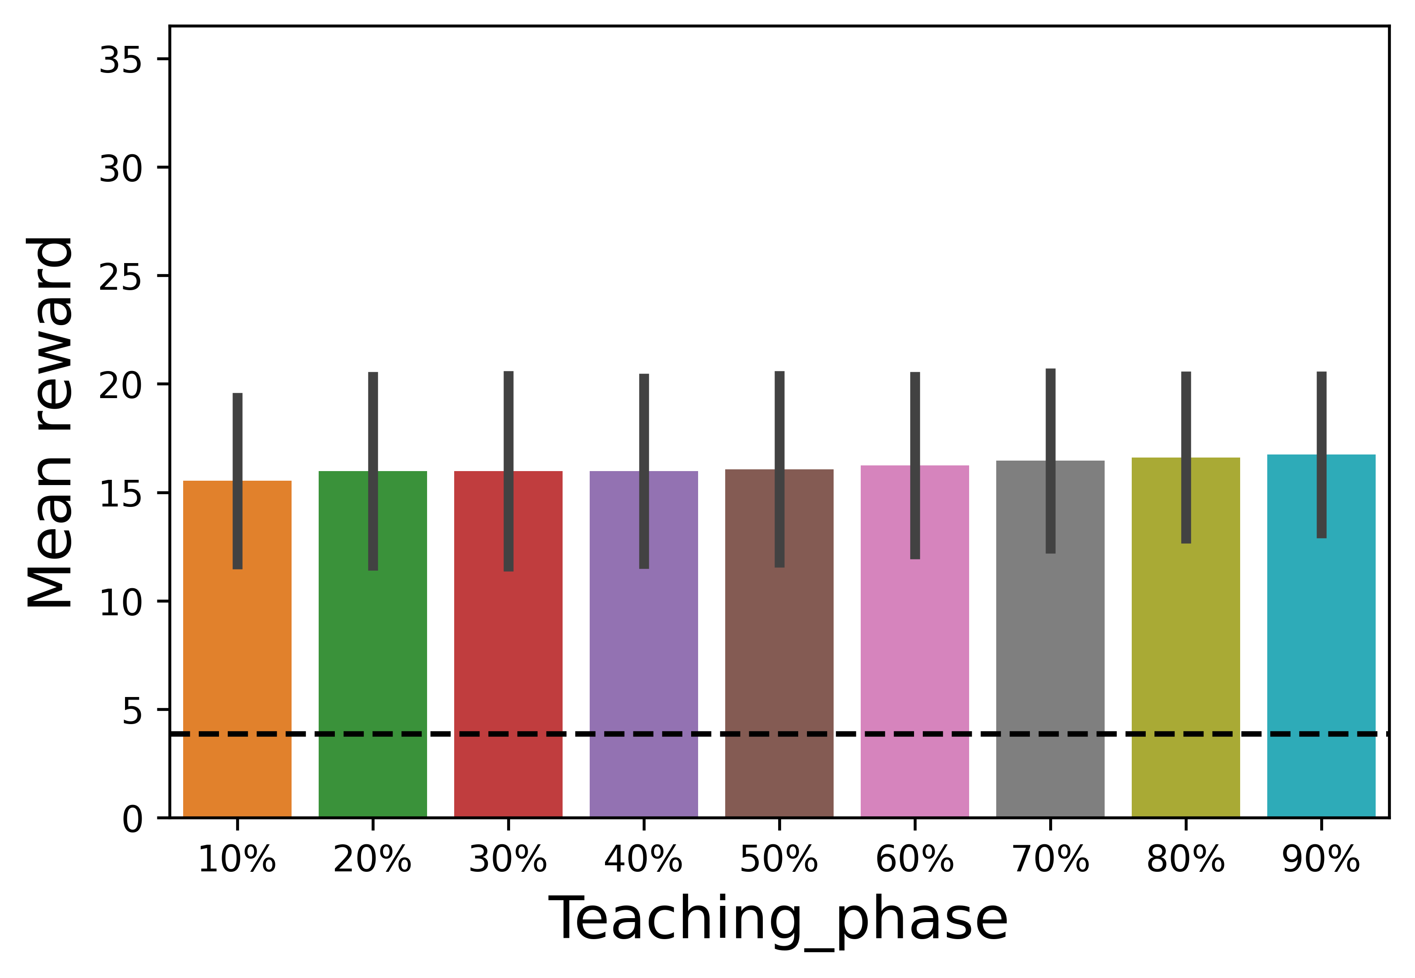
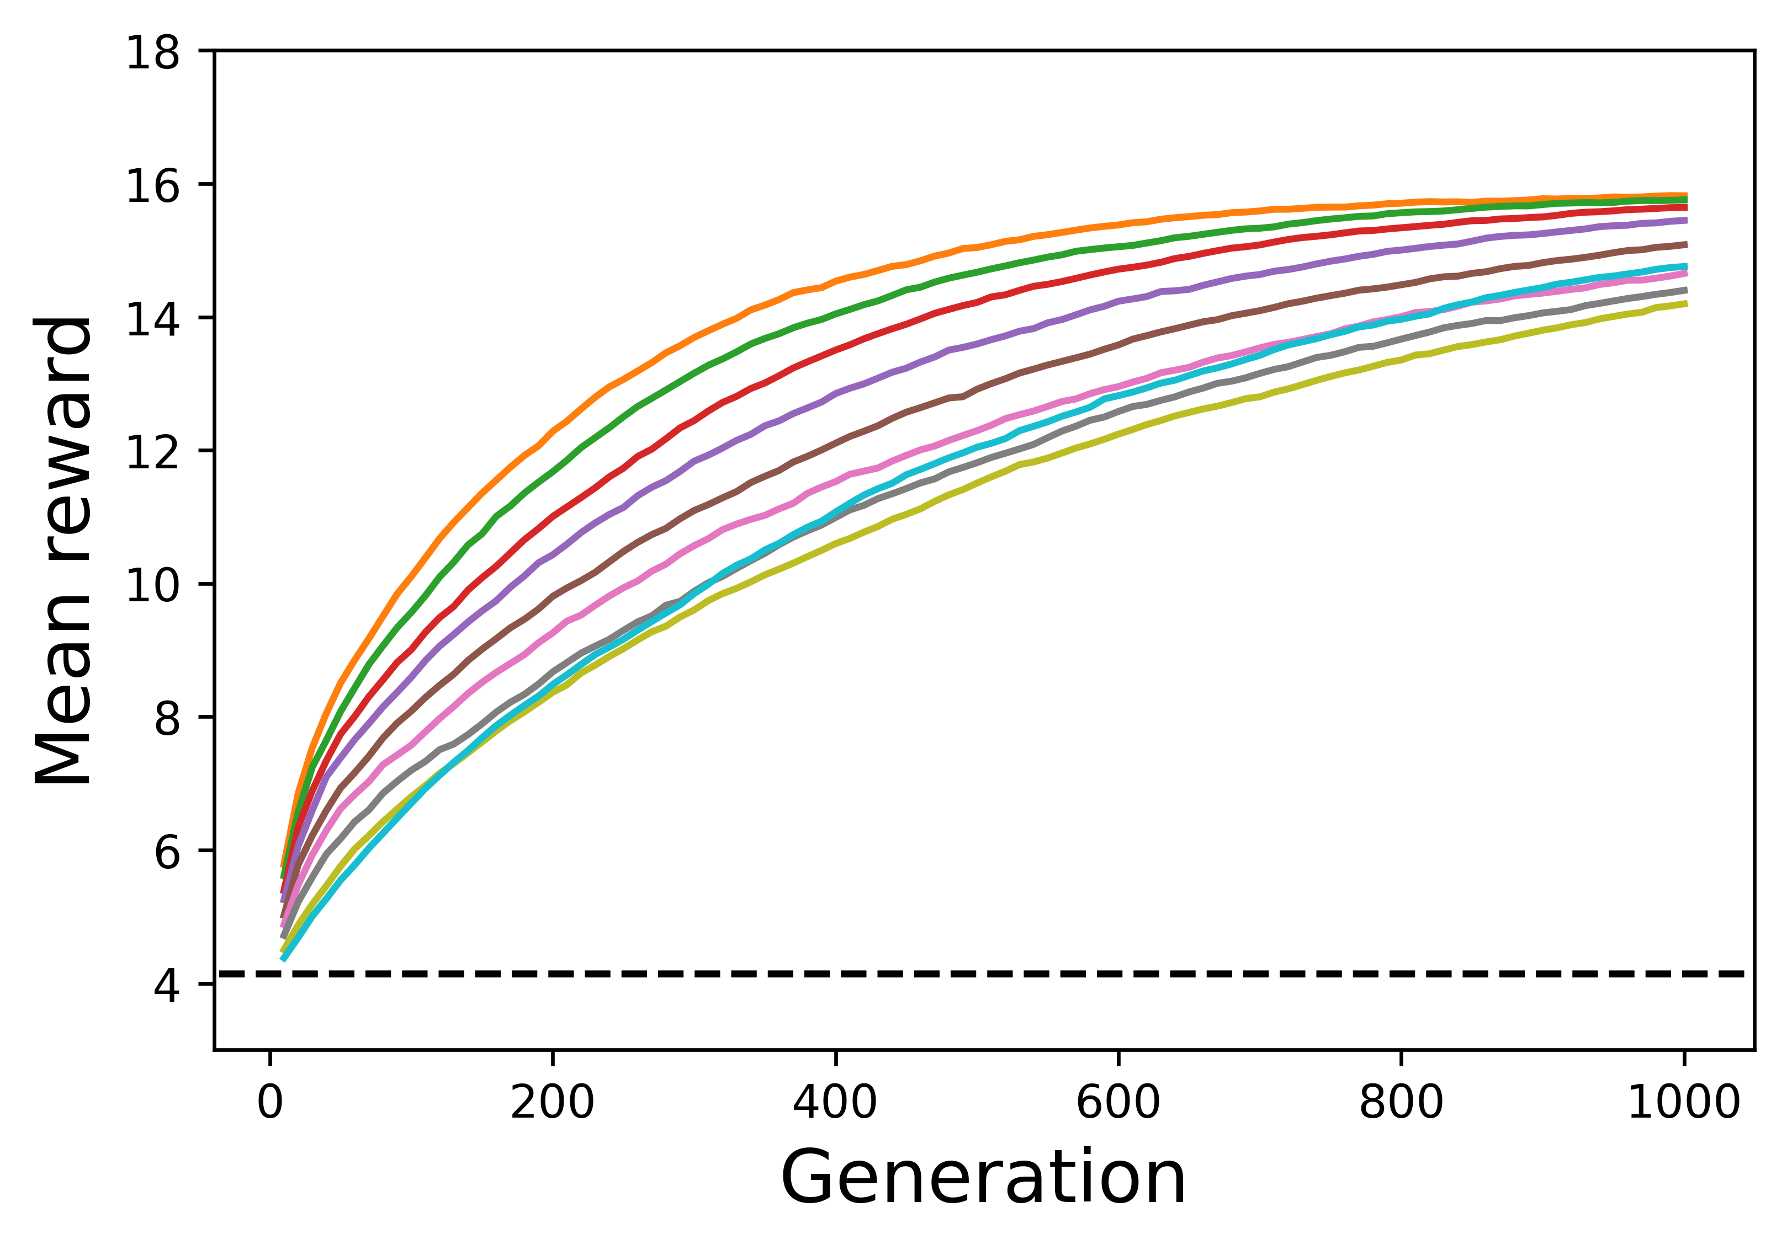
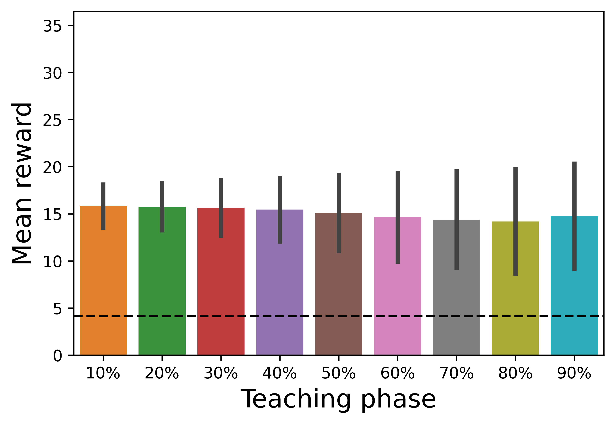
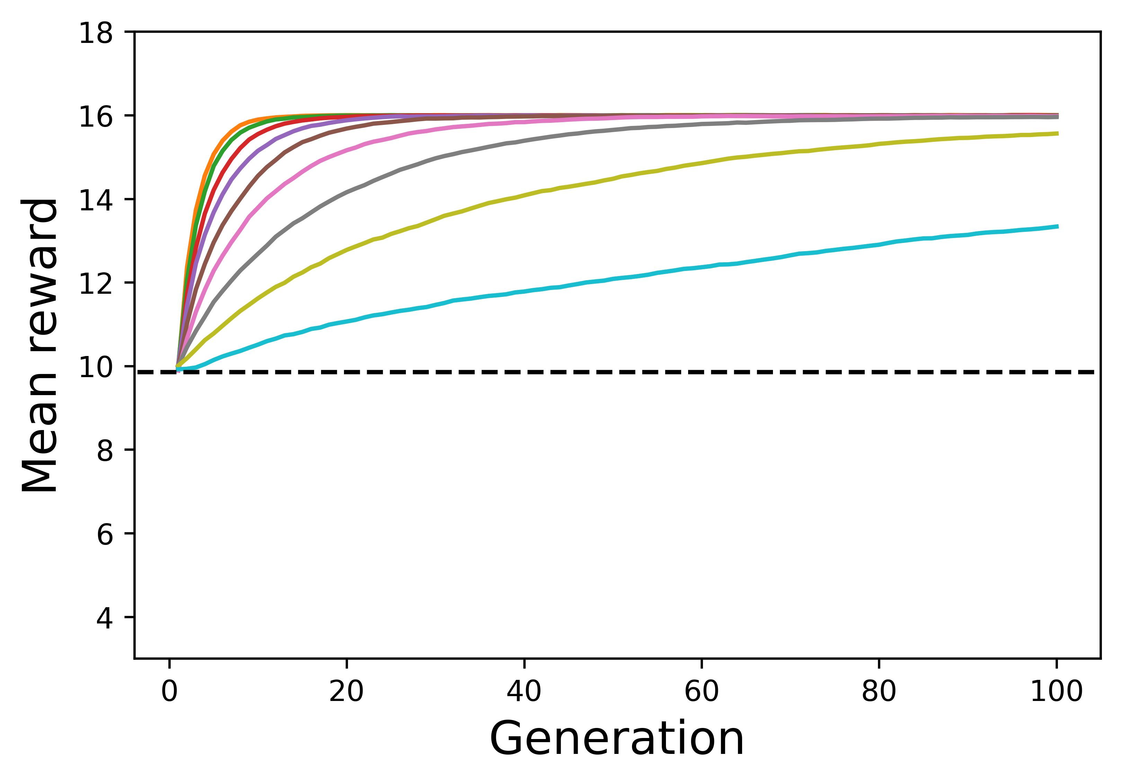
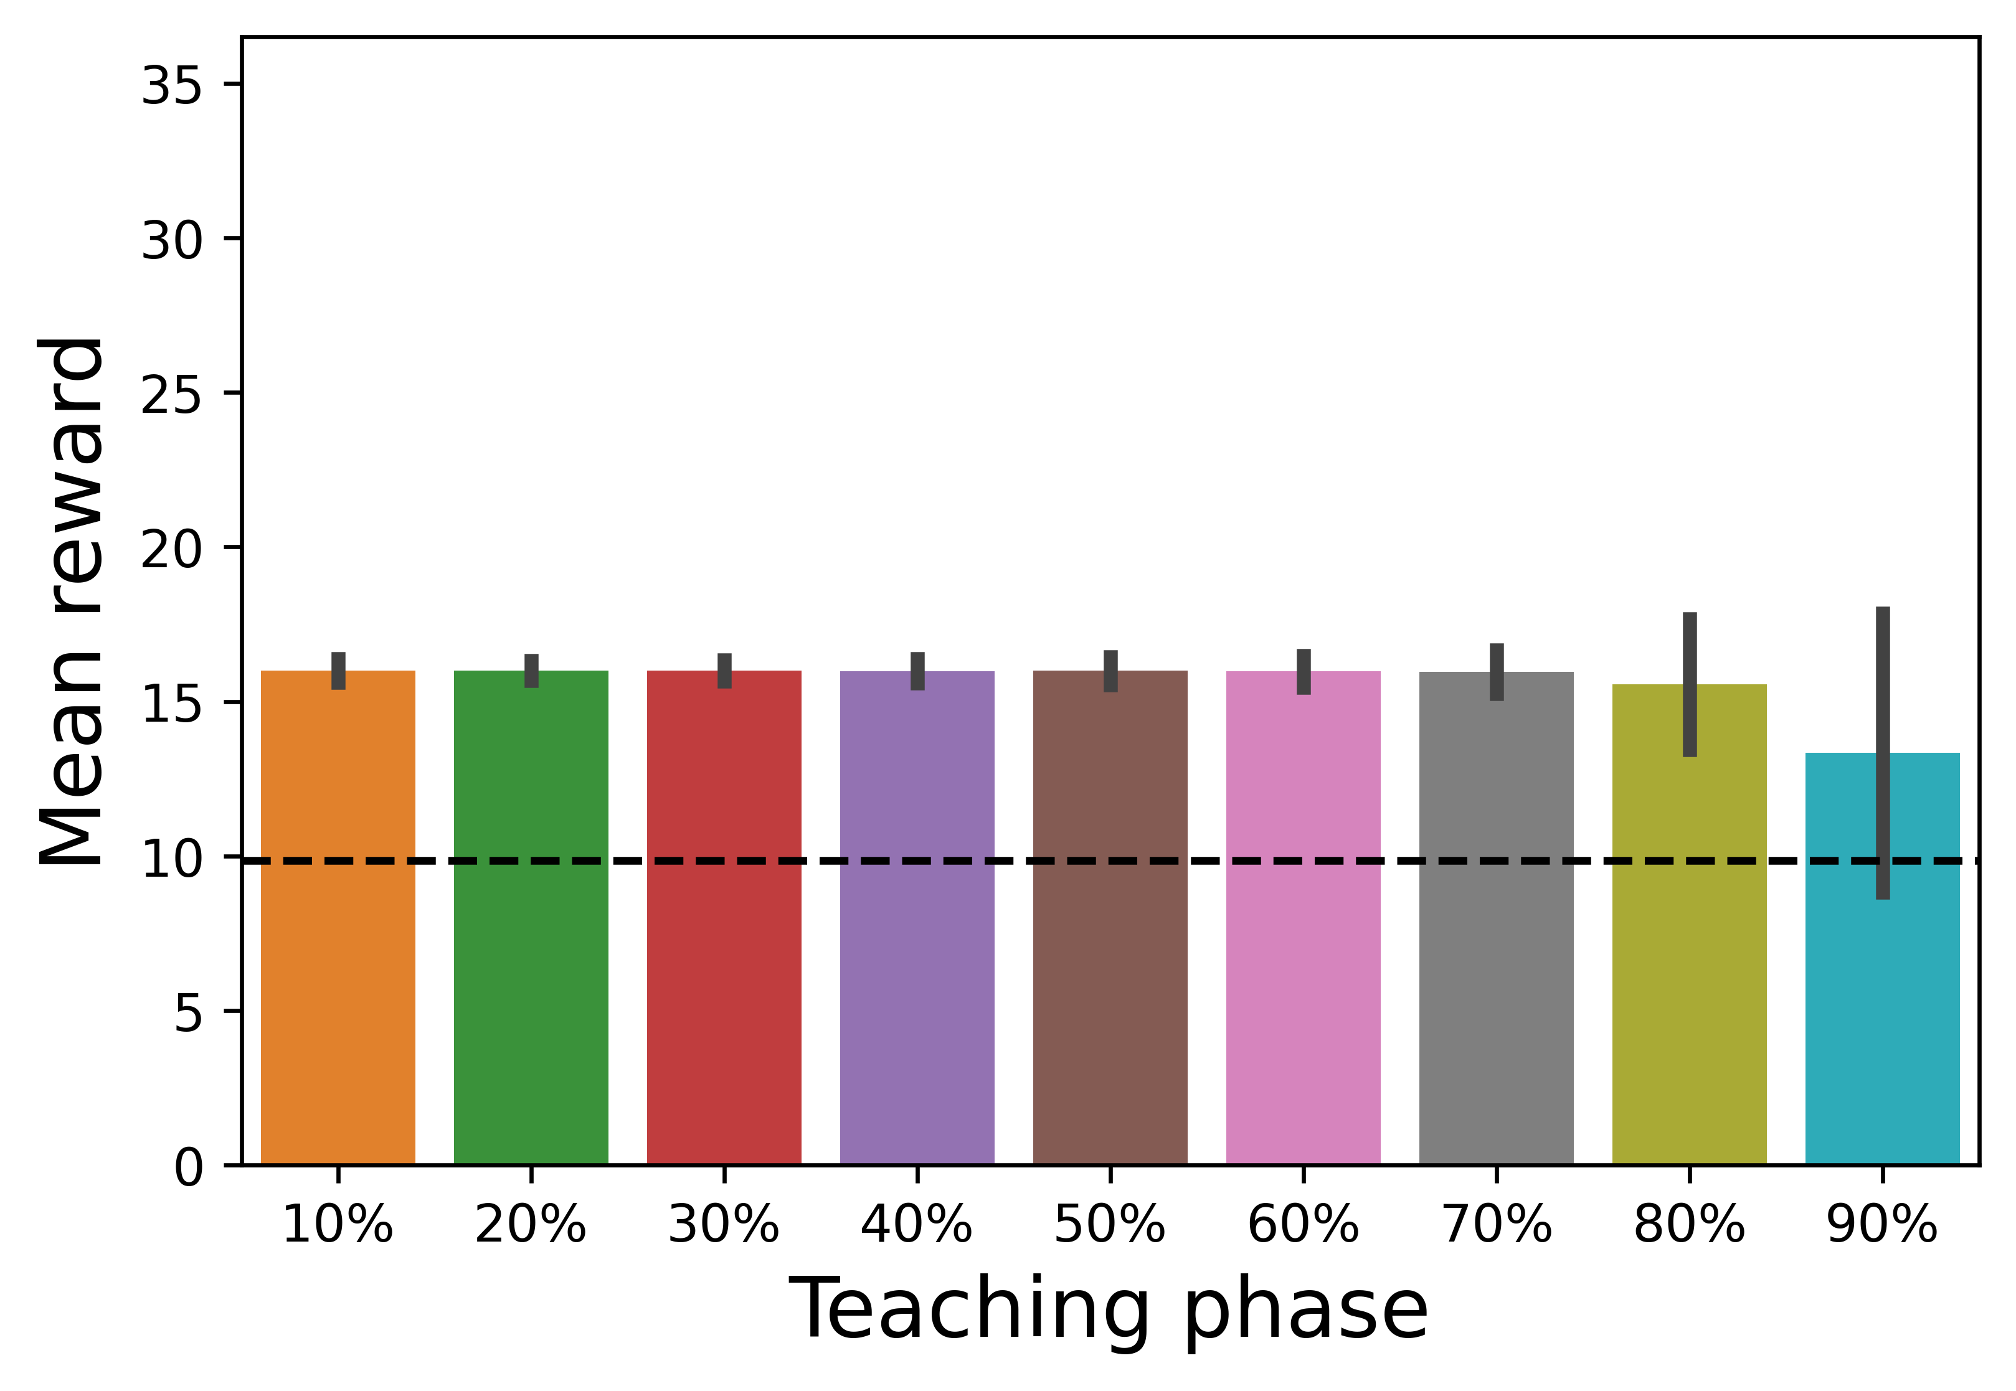
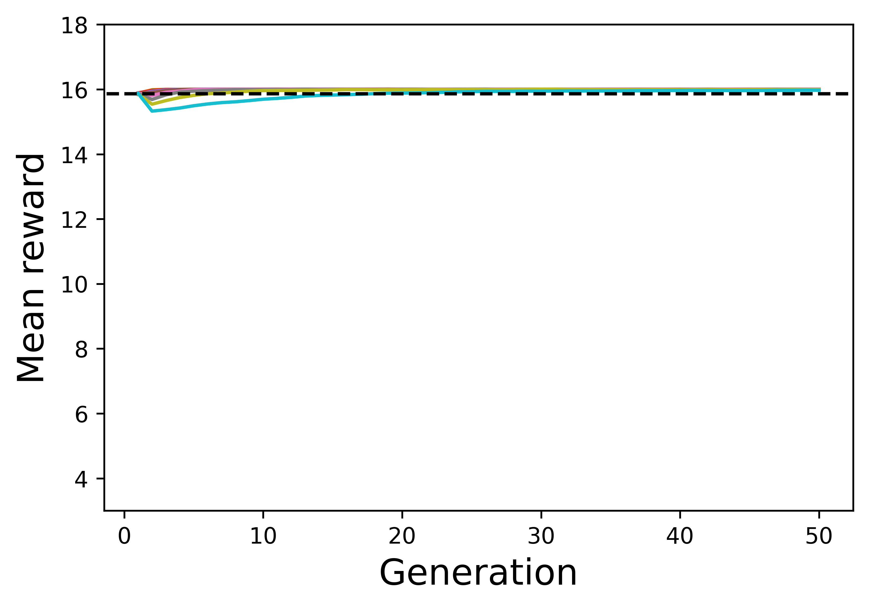
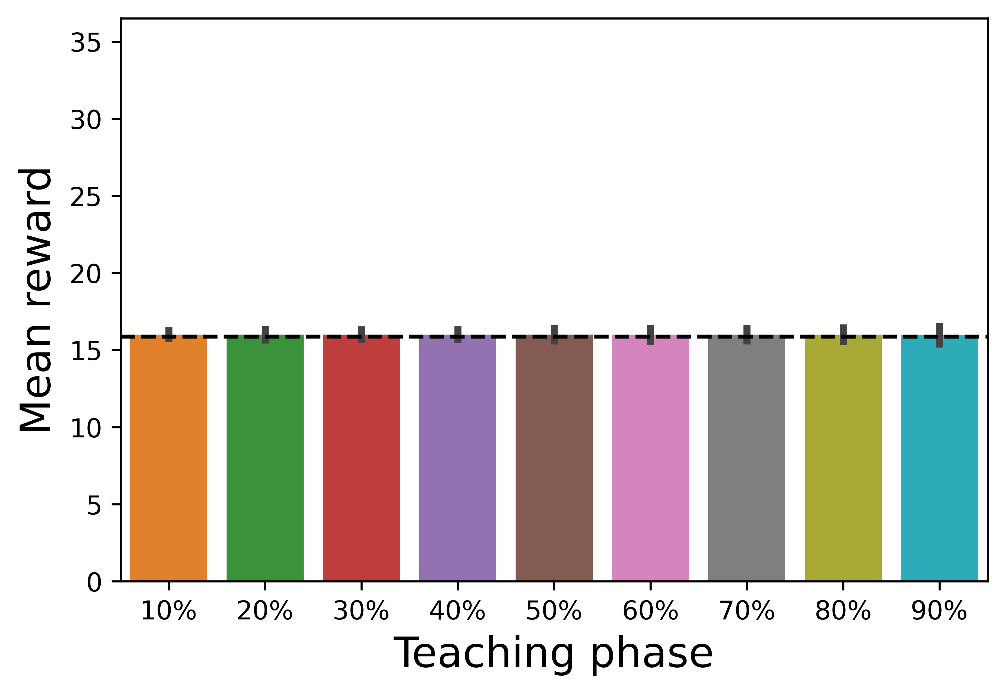
Mean reward in each generation
Mean reward in the final generation
R = 10
R = 100
R = 400
R = 5,000
R = 20,000

Slide 4
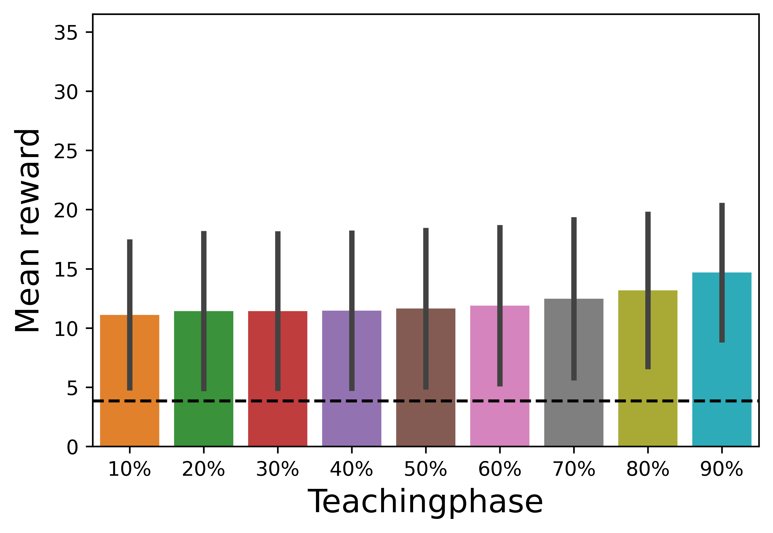
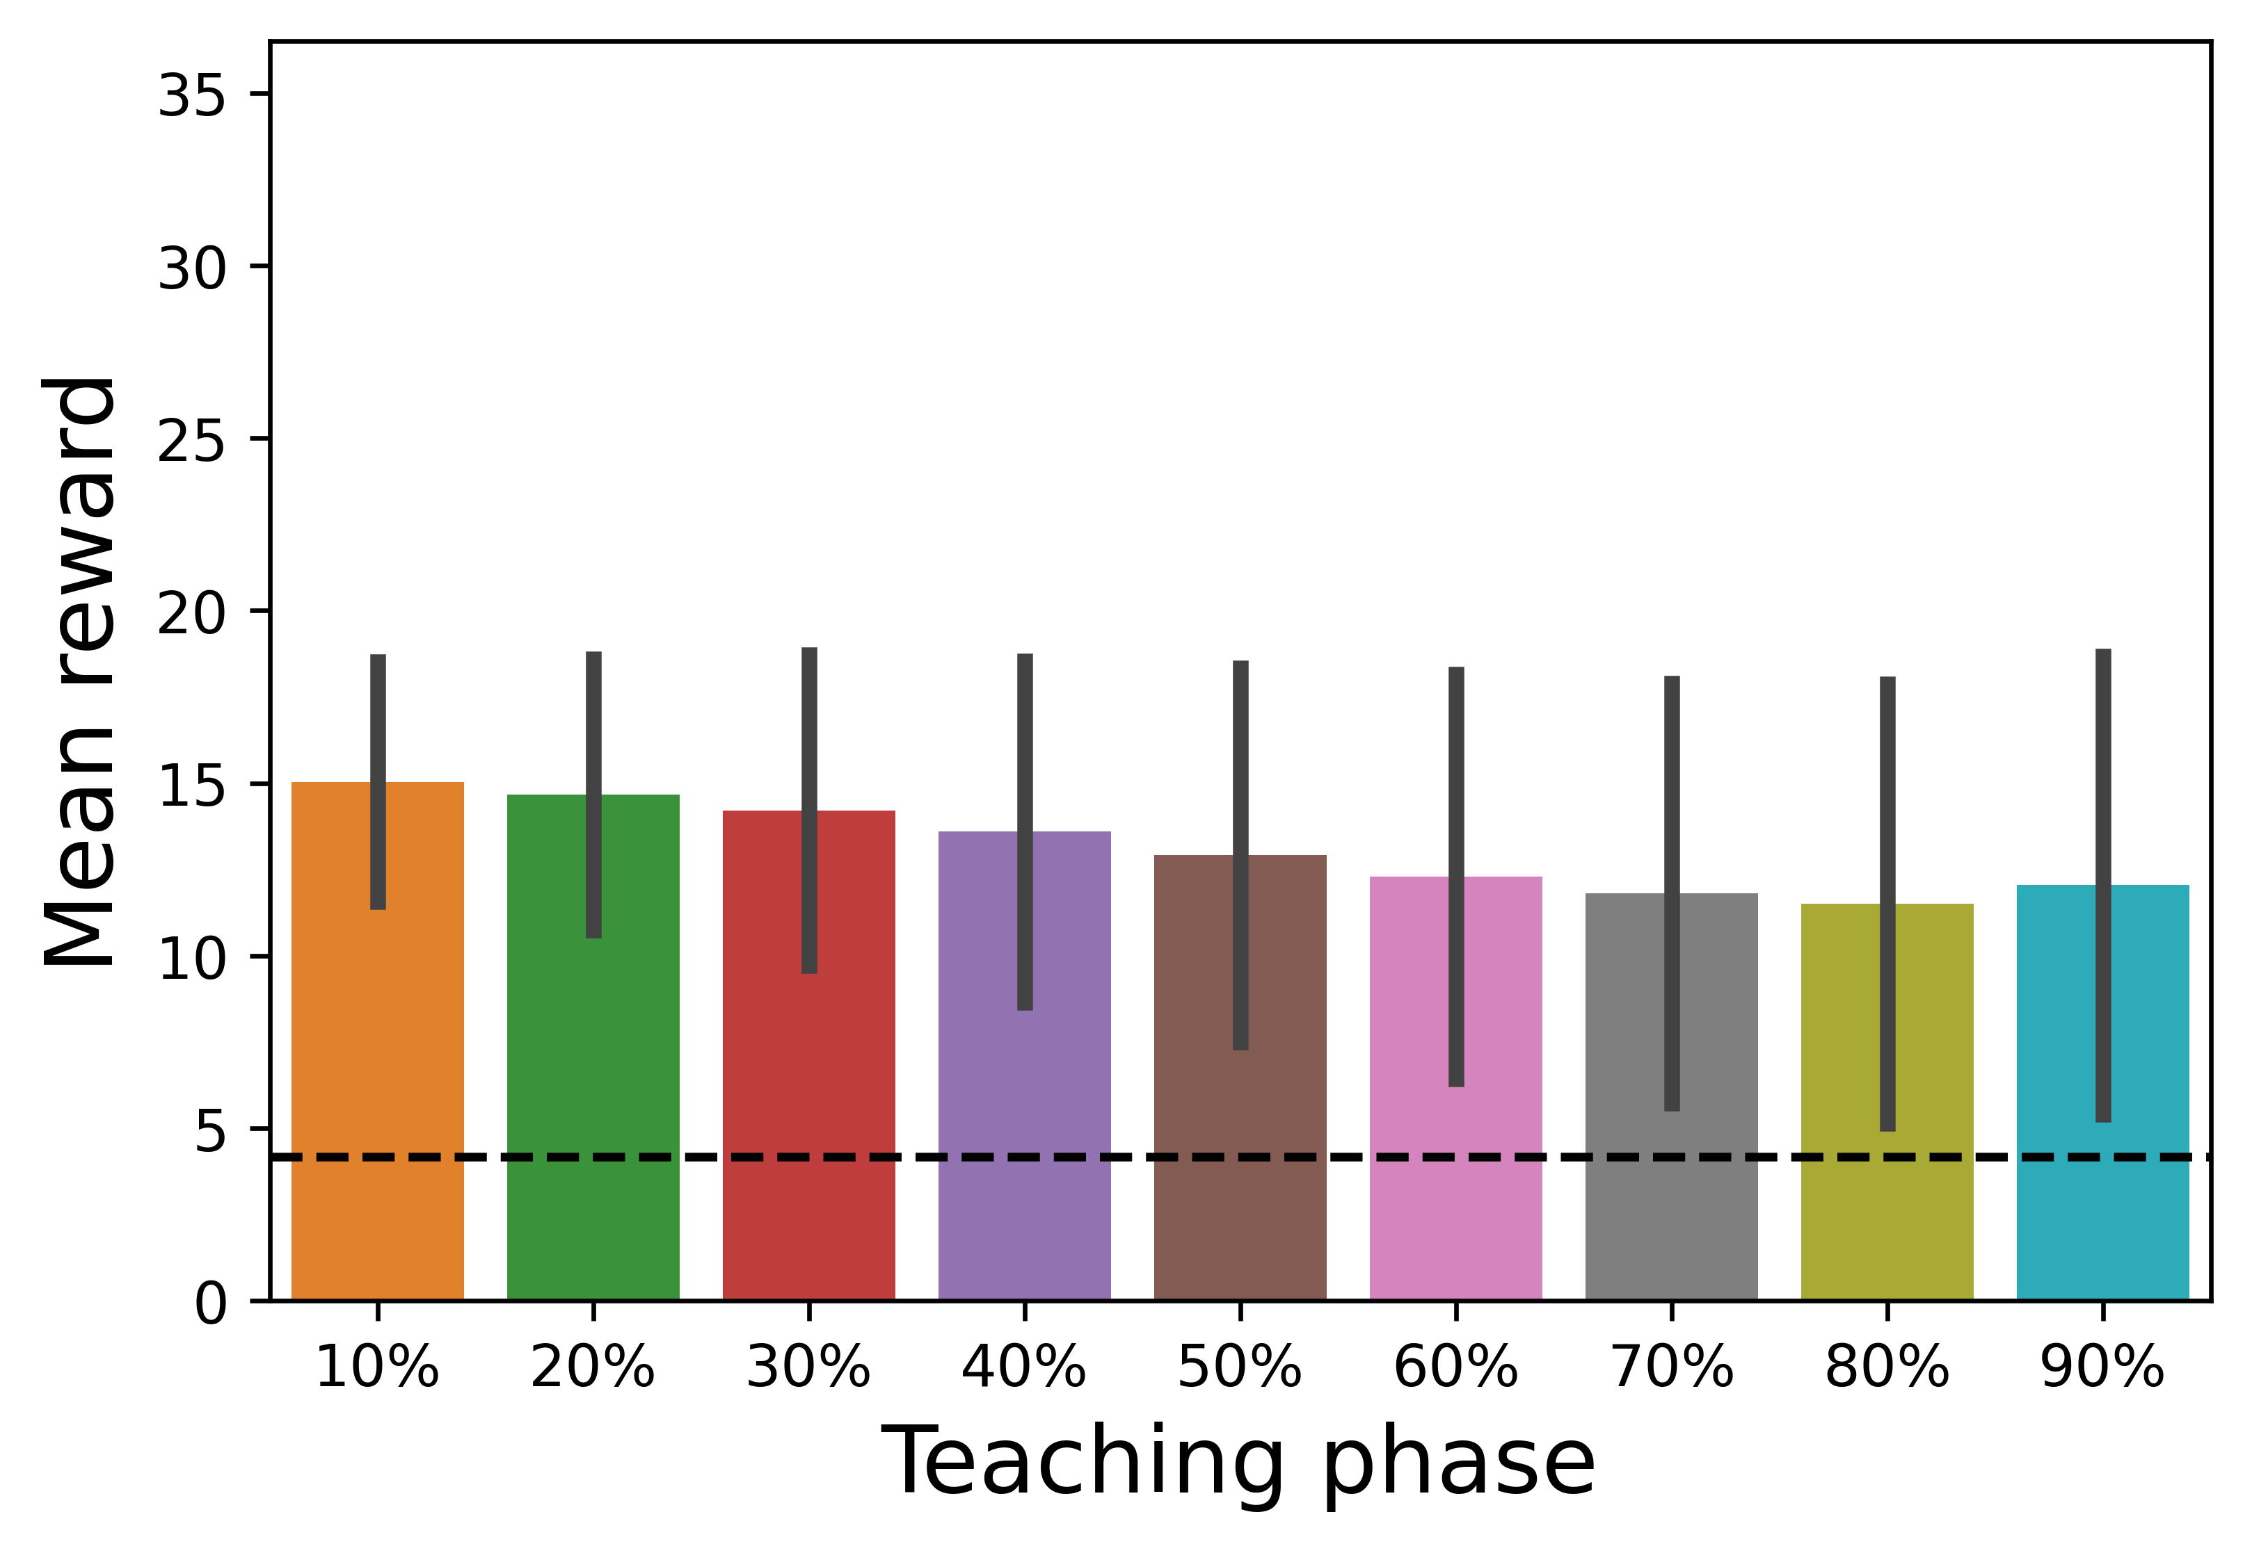
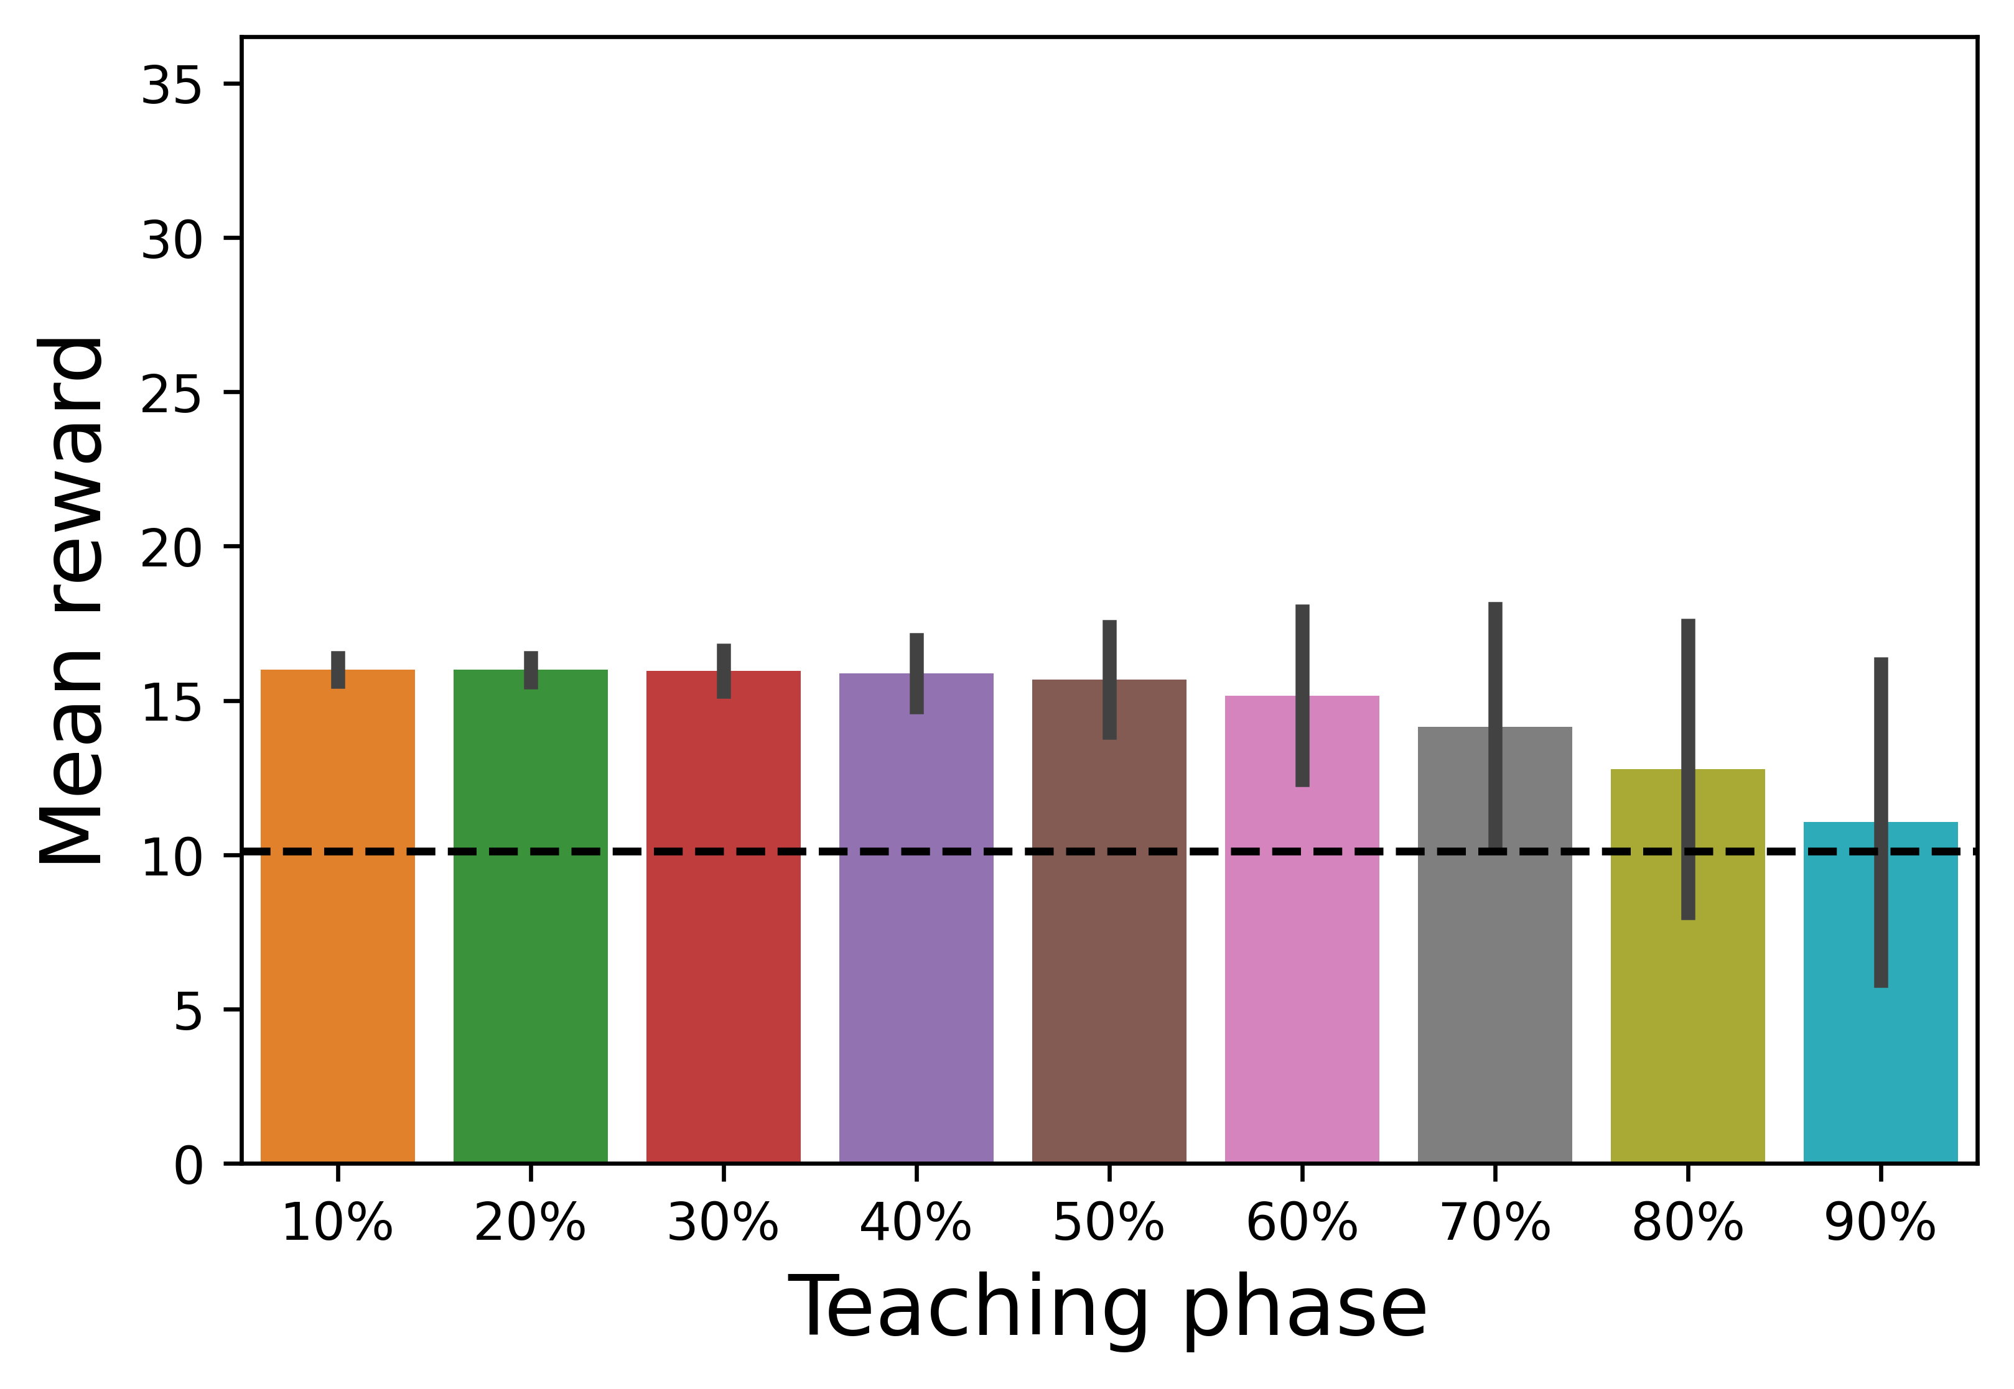

R=100, G=500,G=2000
R=400, G=500,G=1000
R=5000, G=20,G=100
R=20000, G=10,G=50

Slide 5
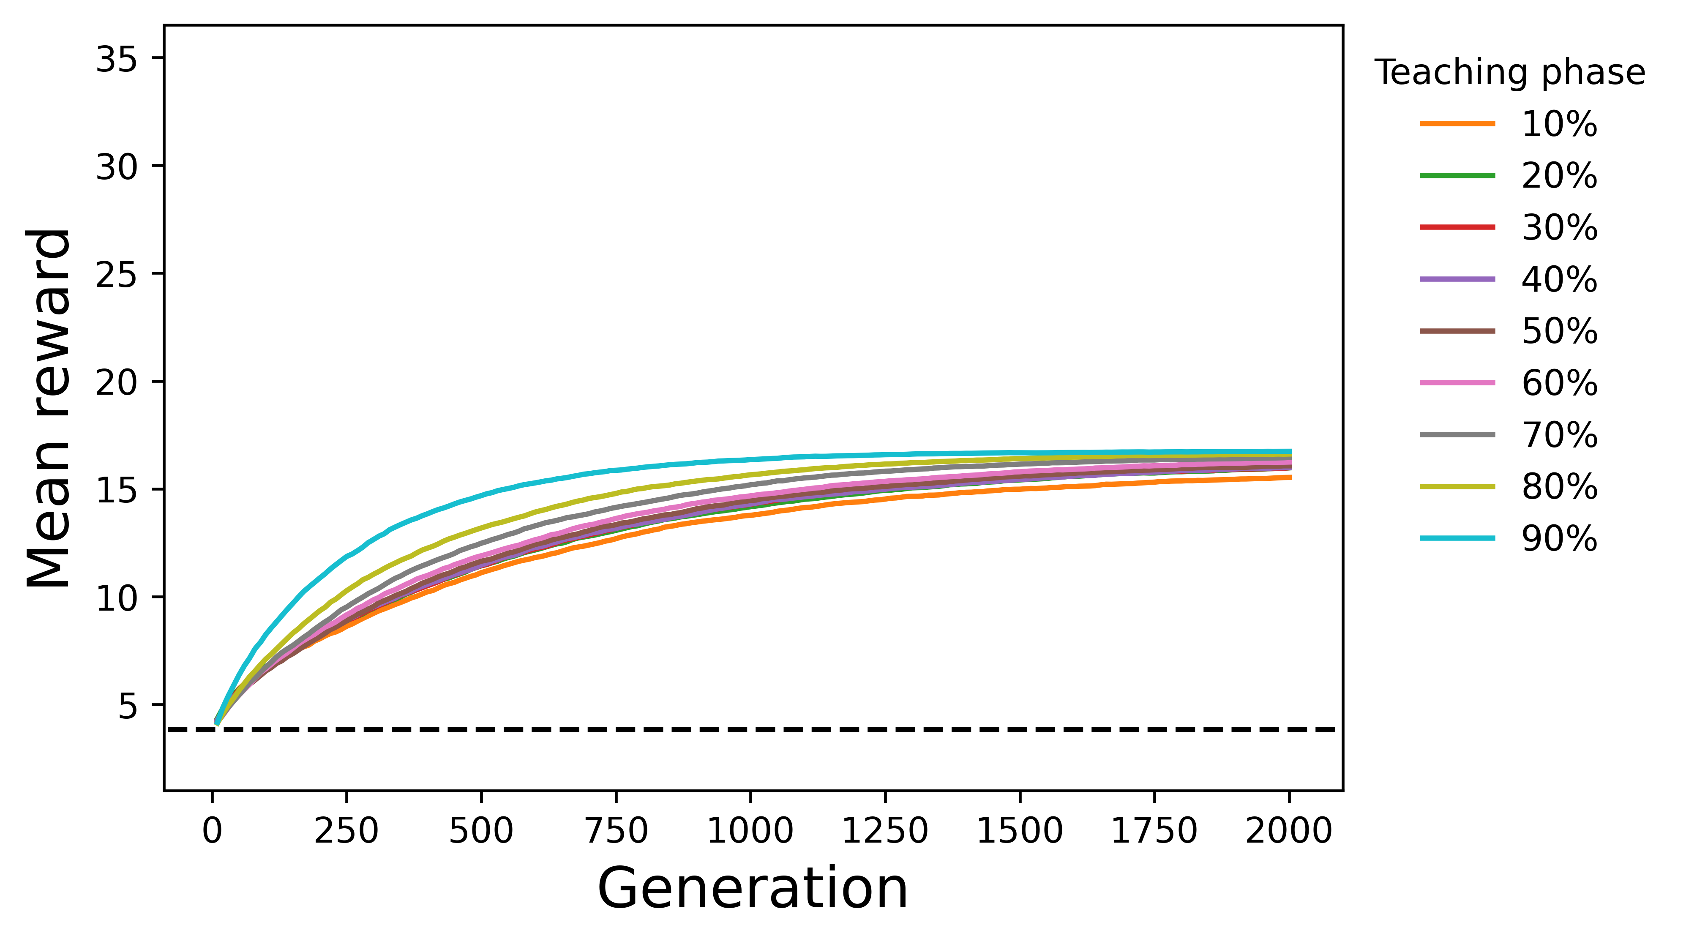
A1 (R = 100)
B1 (R = 100, 500th Generation)
C1 (R = 100, 2000th Generation)

Slide 6
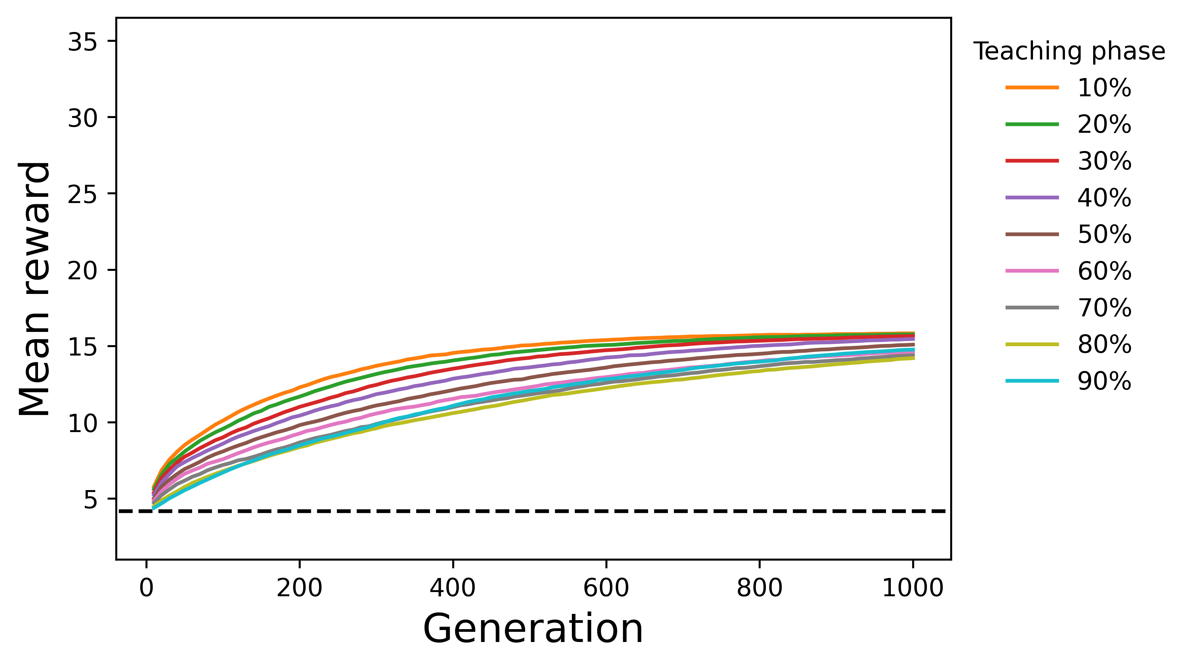
A2 (R = 400)
B2 (R = 400, 500th Generation)
C2 (R = 400, 1000th Generation)

Slide 7
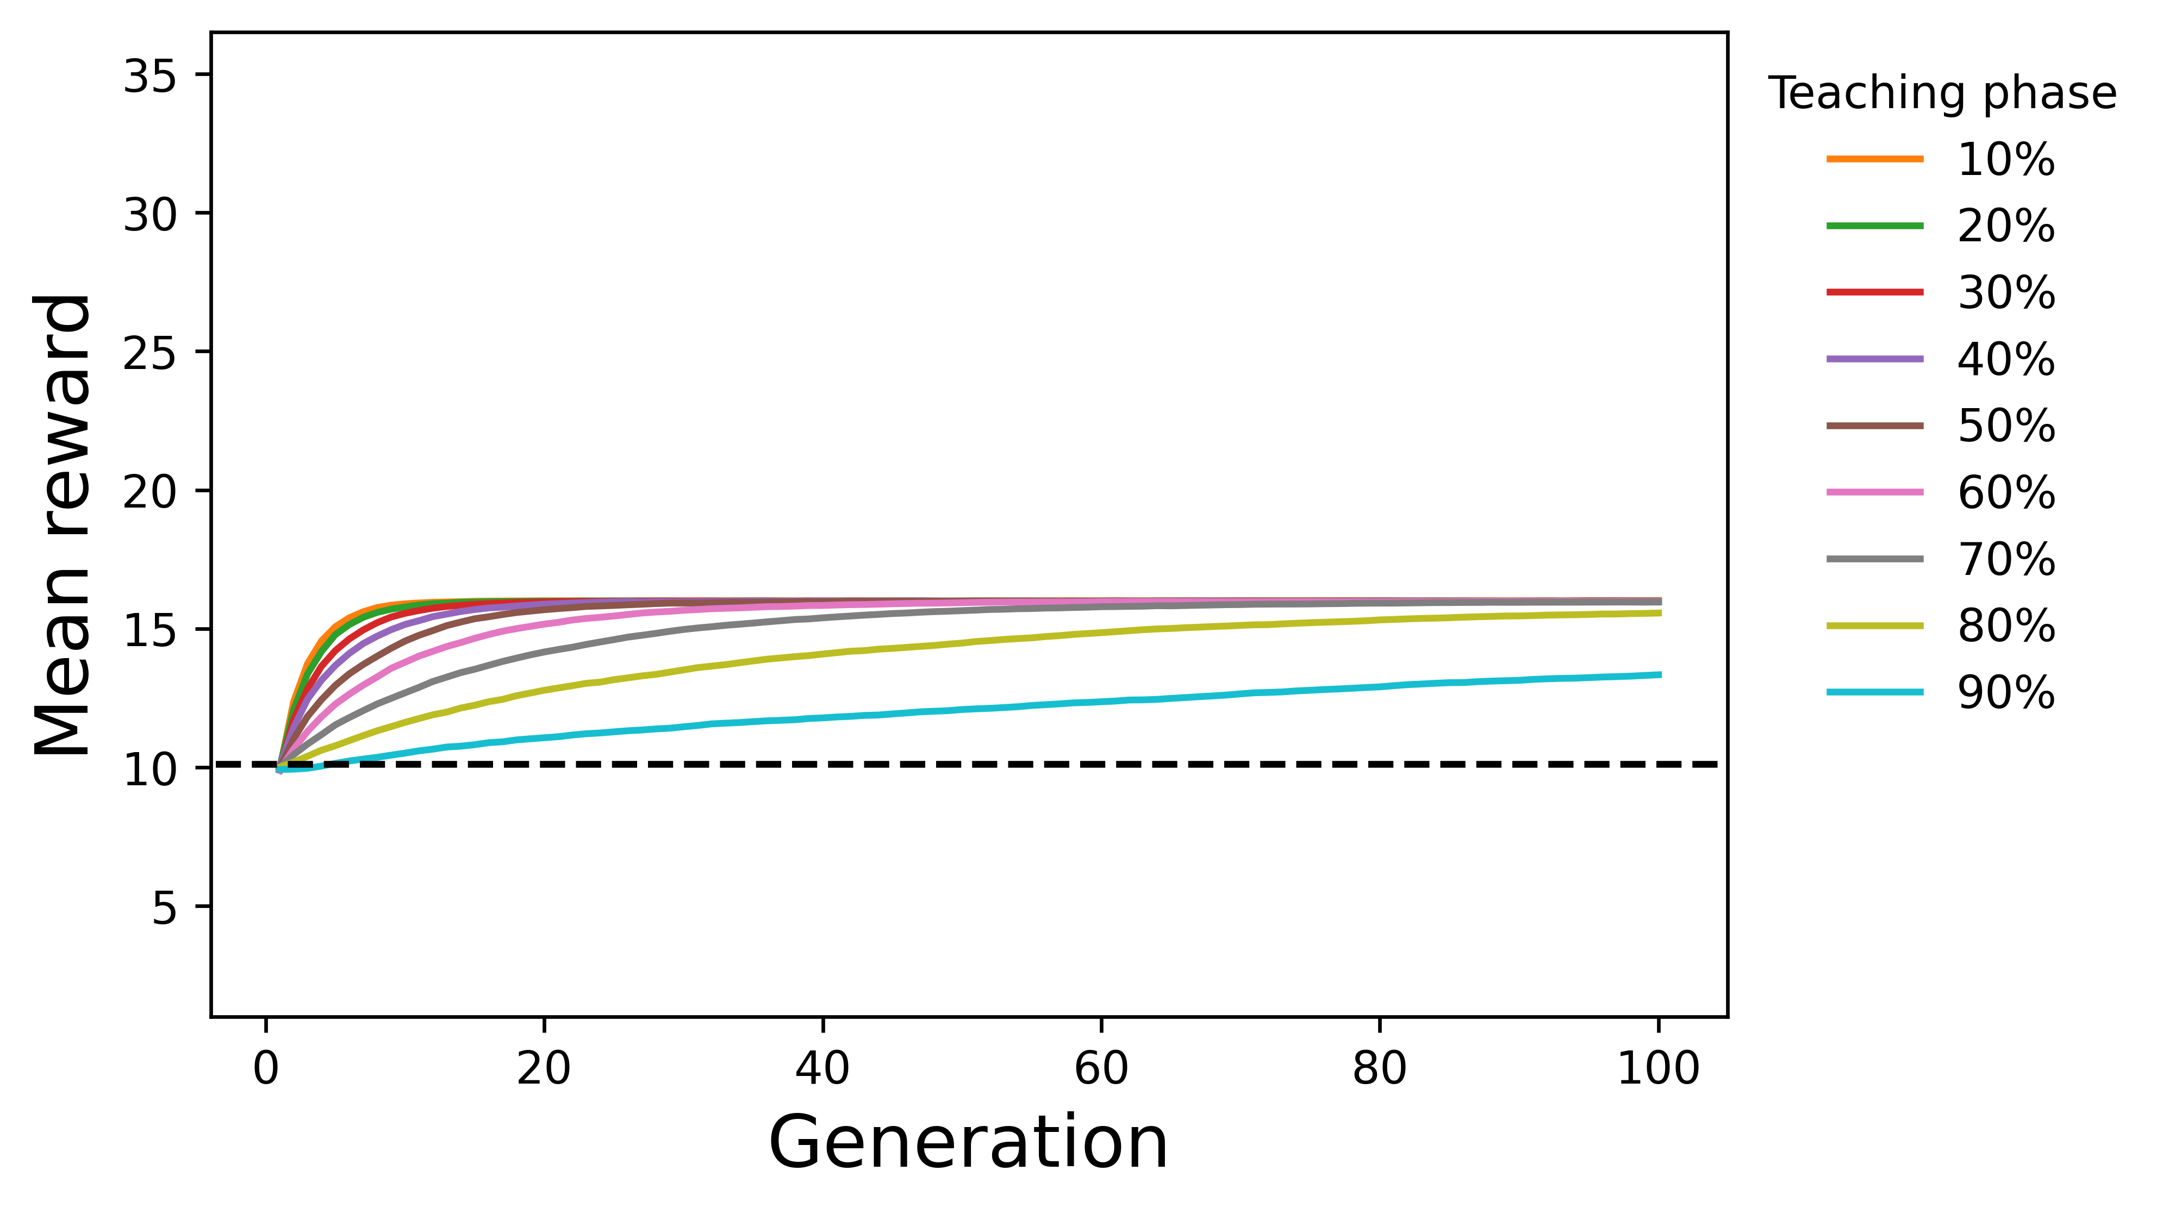
A3 (R = 5000)
B3 (R = 5000, 20th Generation)
C3 (R = 5000, 100th Generation)

Slide 8
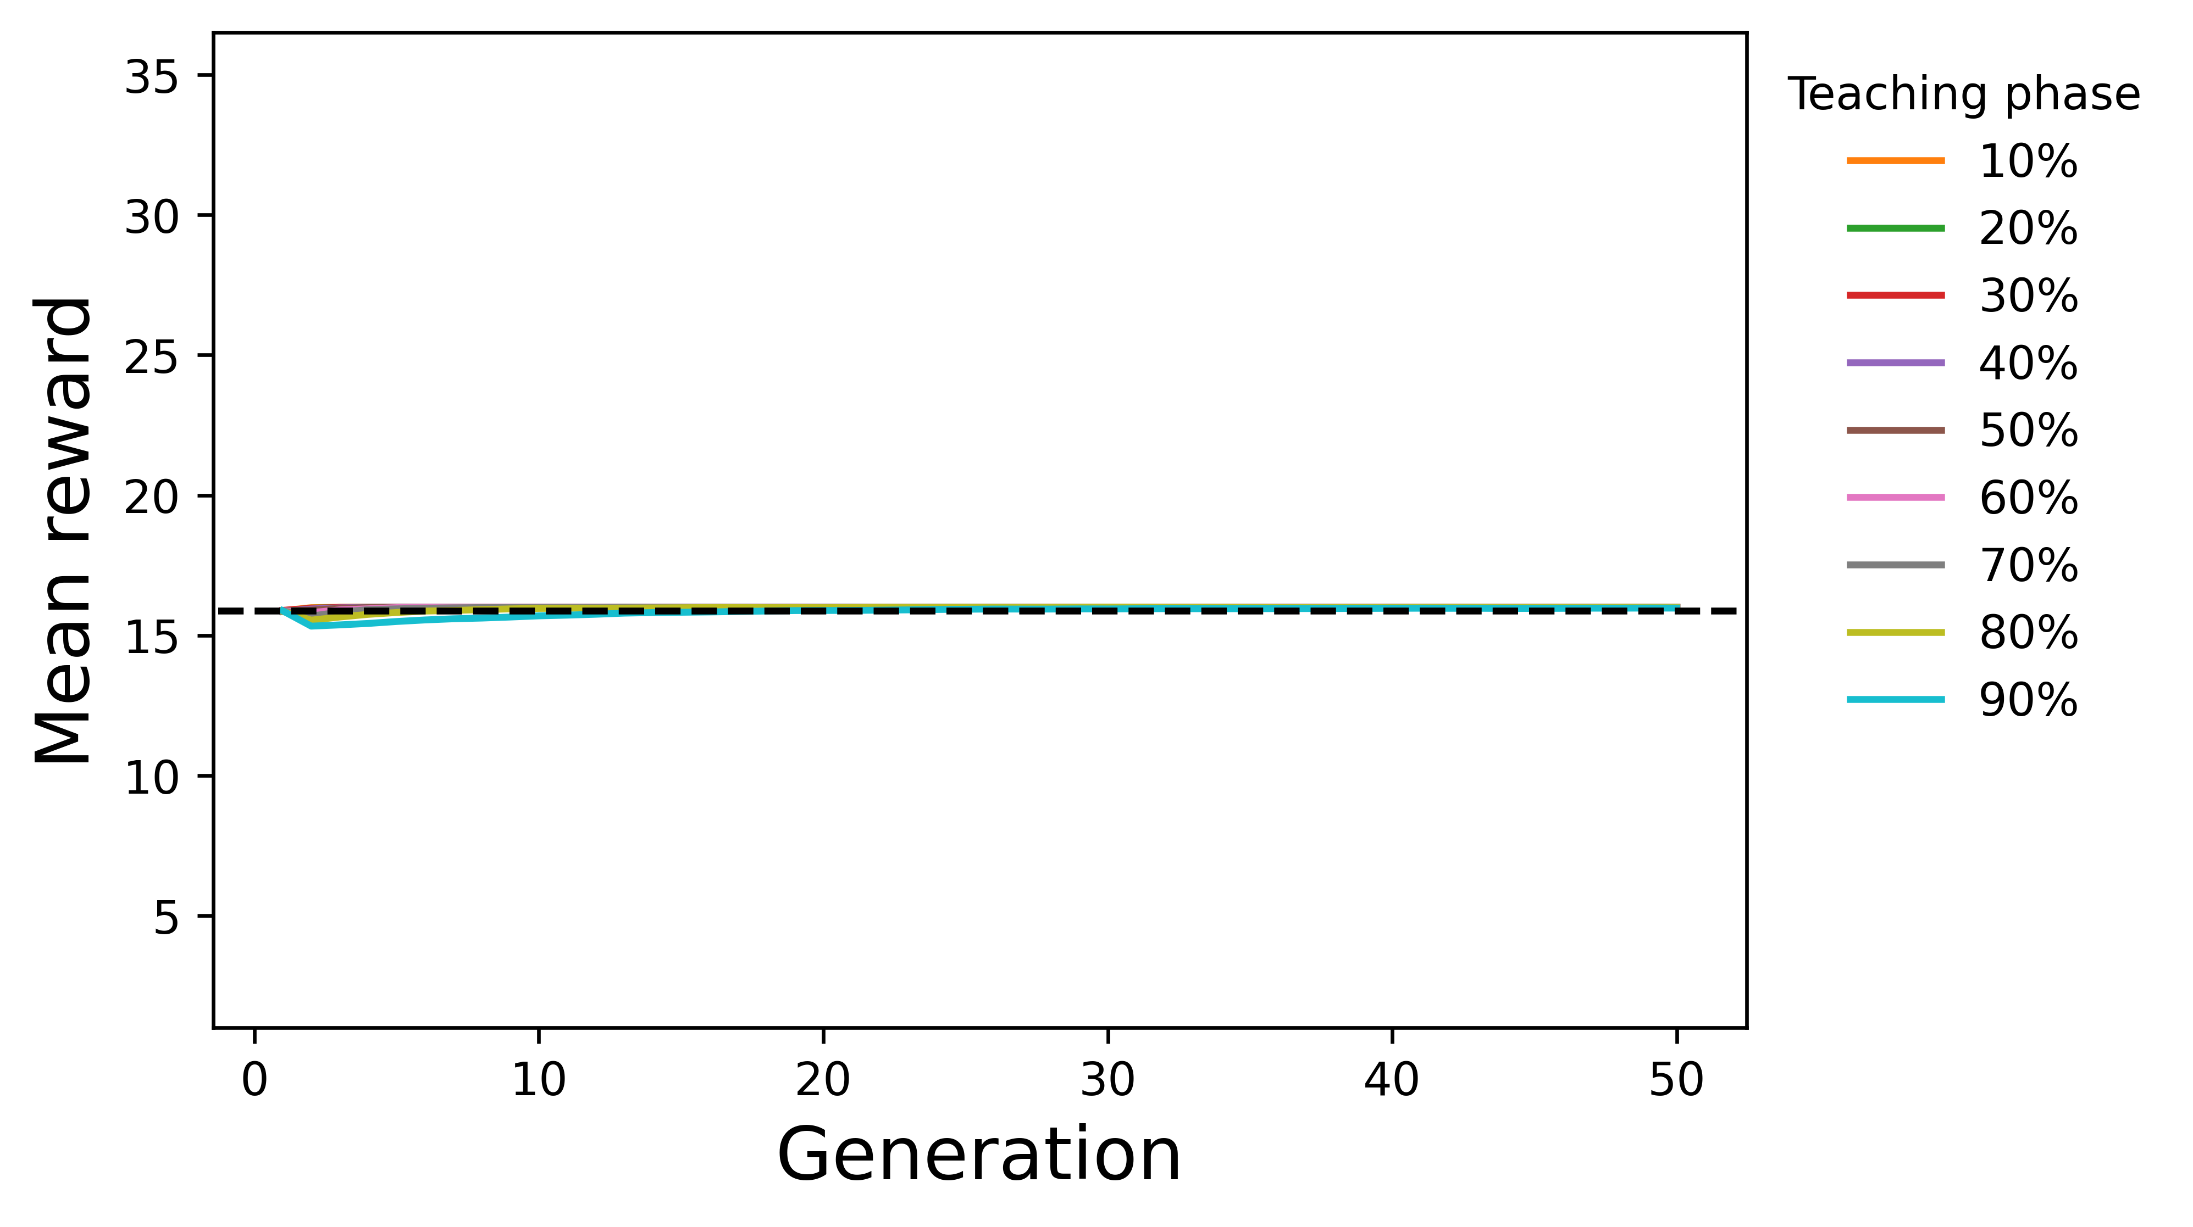
A4 (R = 20000)
B4 (R = 20000, 10th Generation)
C4 (R = 20000, 50th Generation)

Slide 9
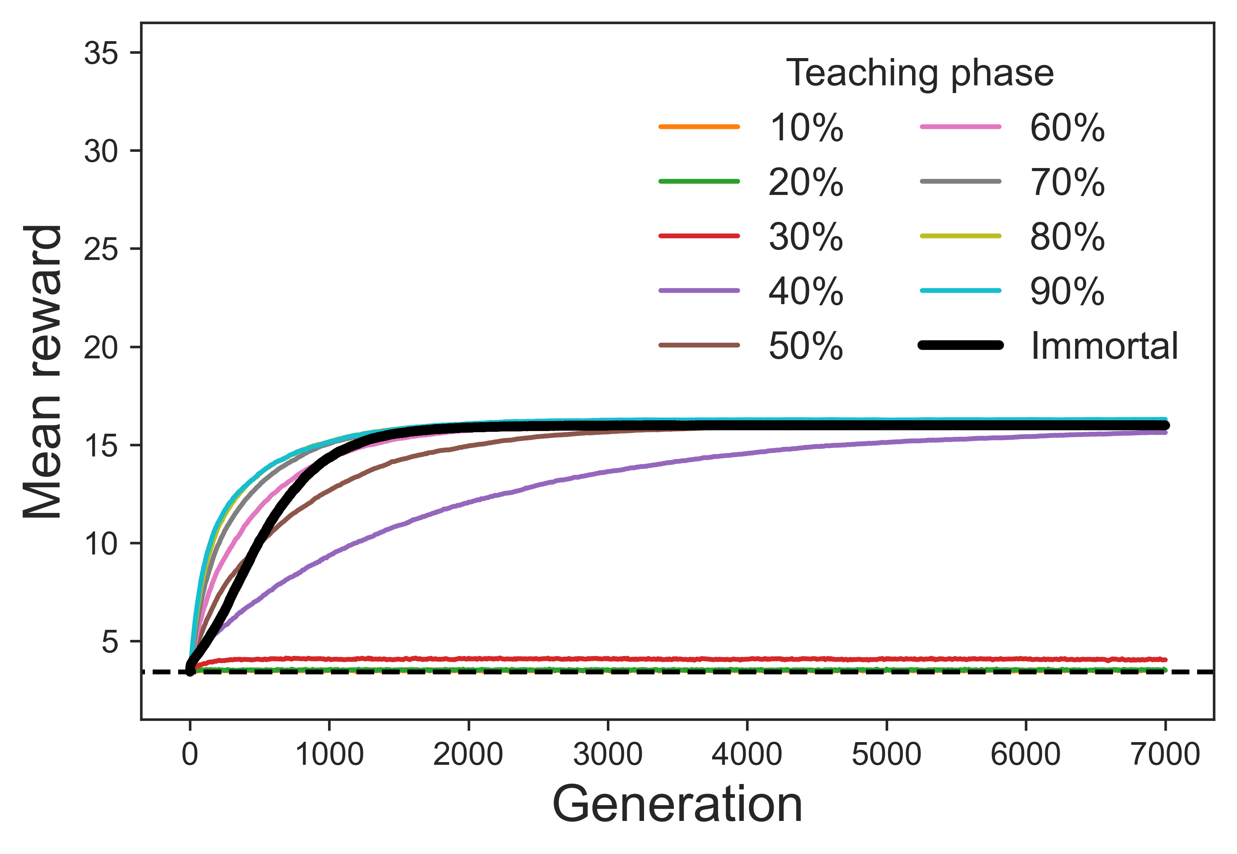
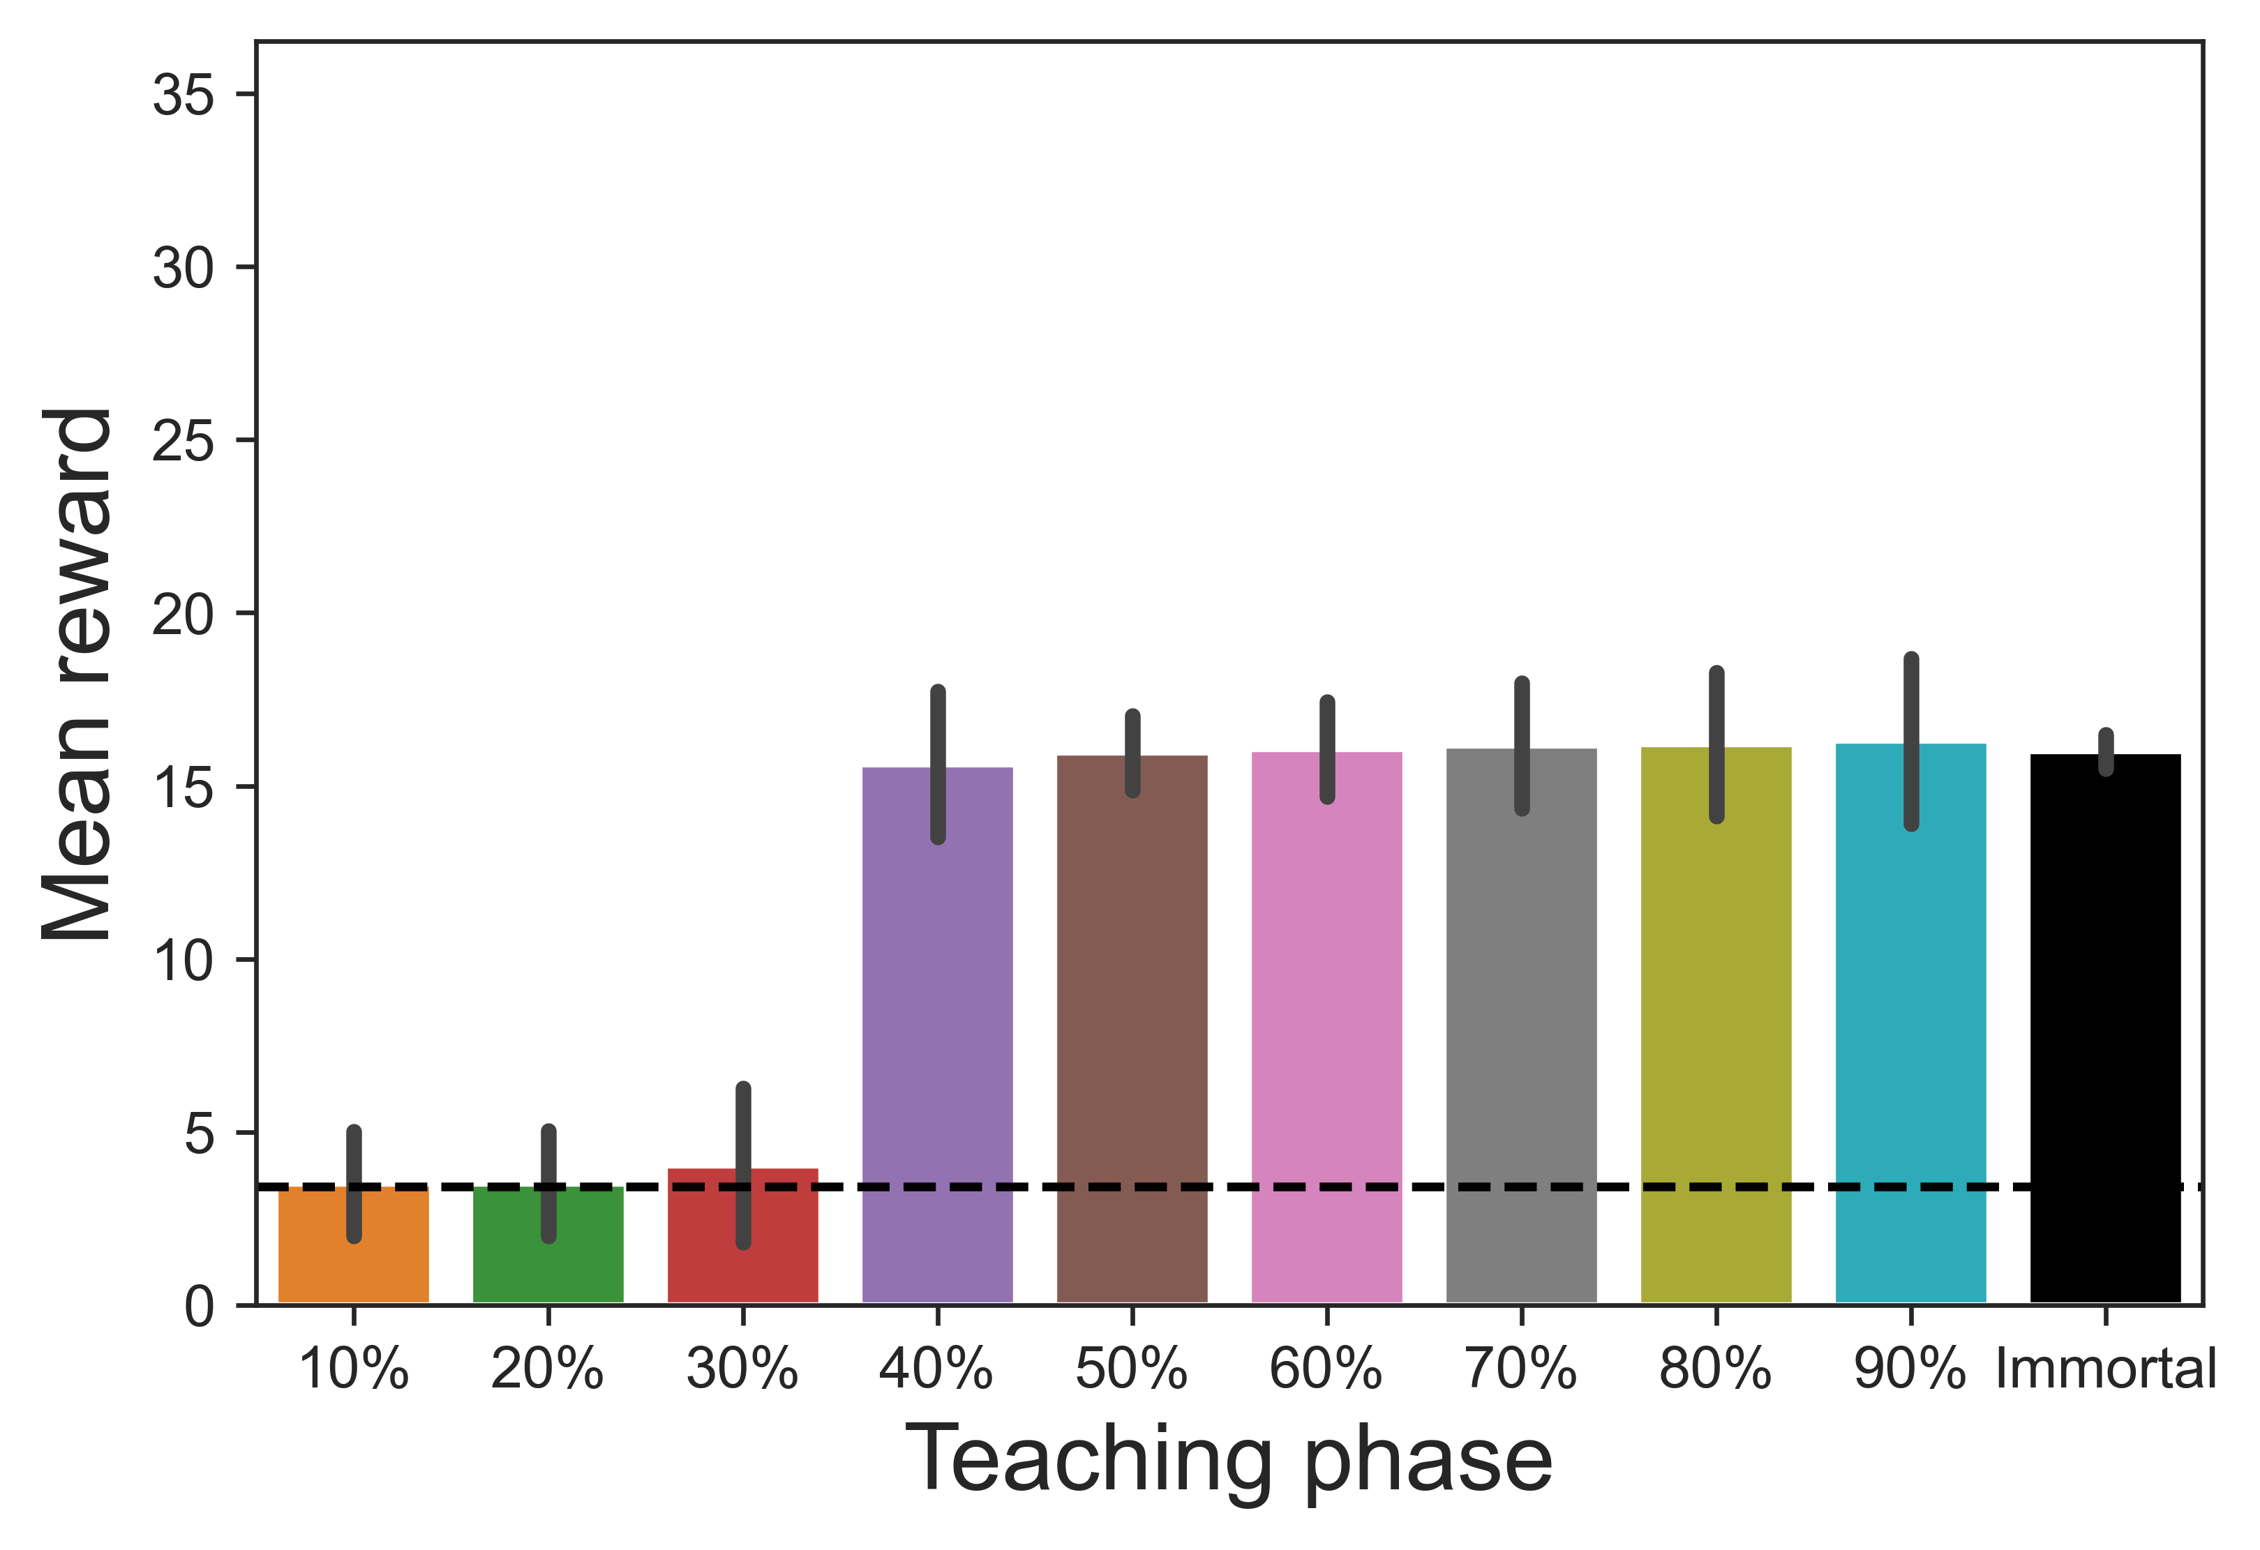
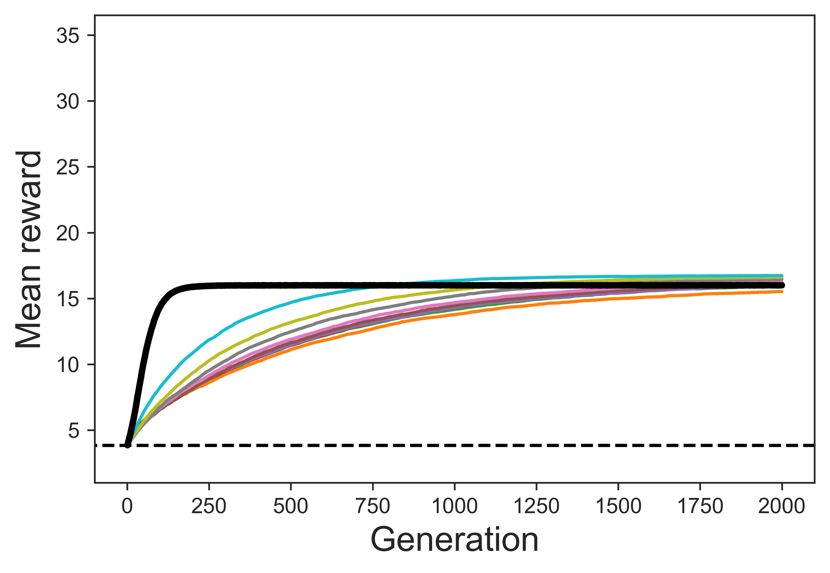
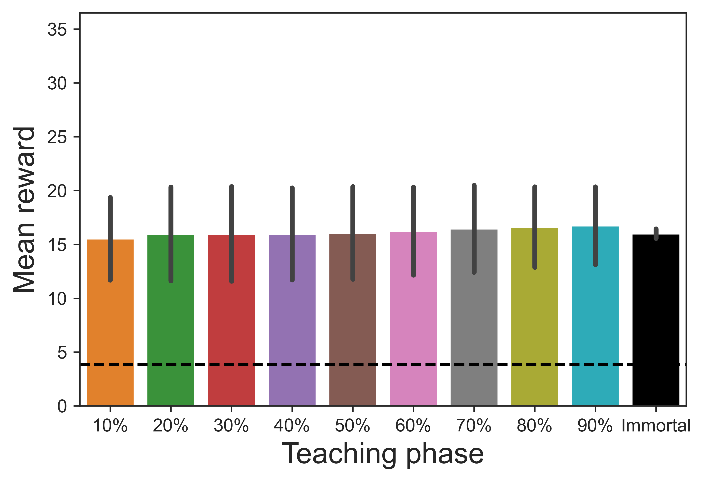
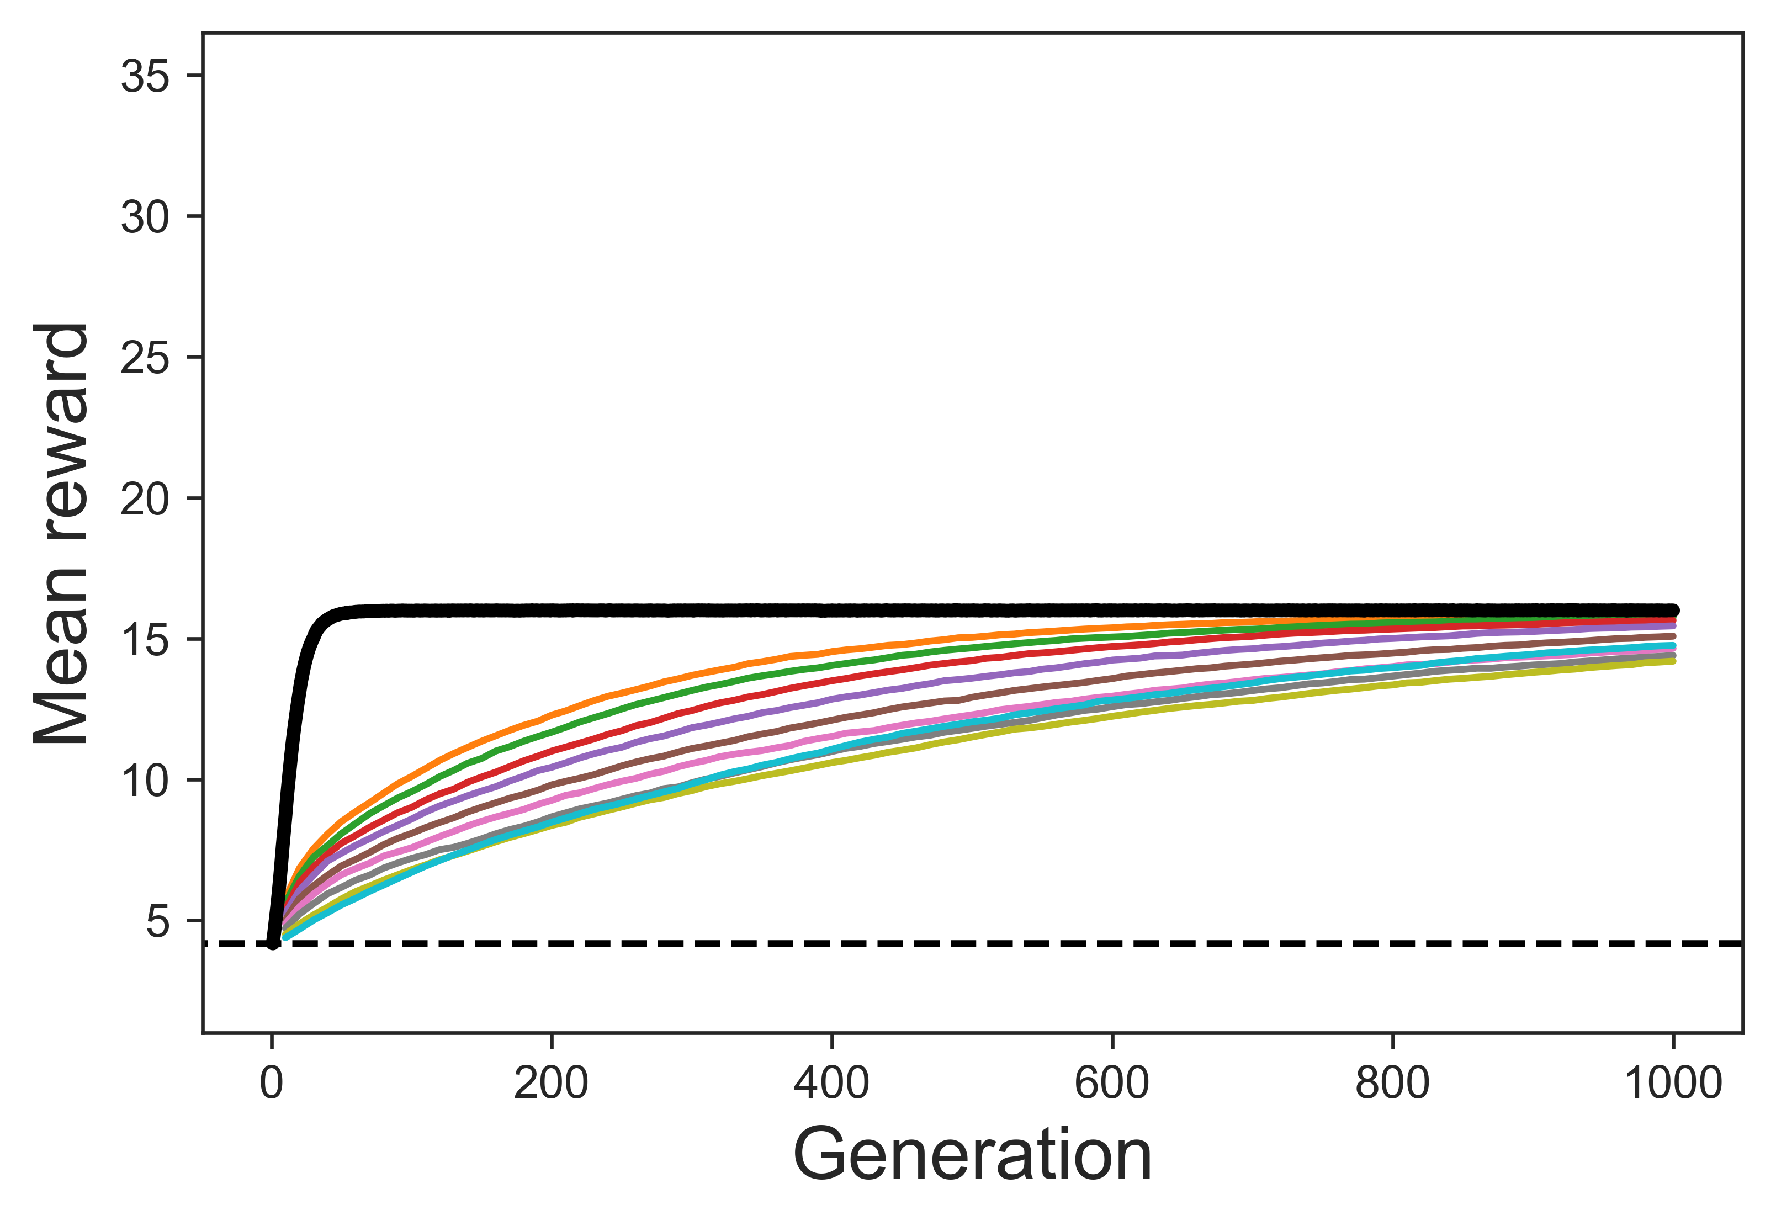
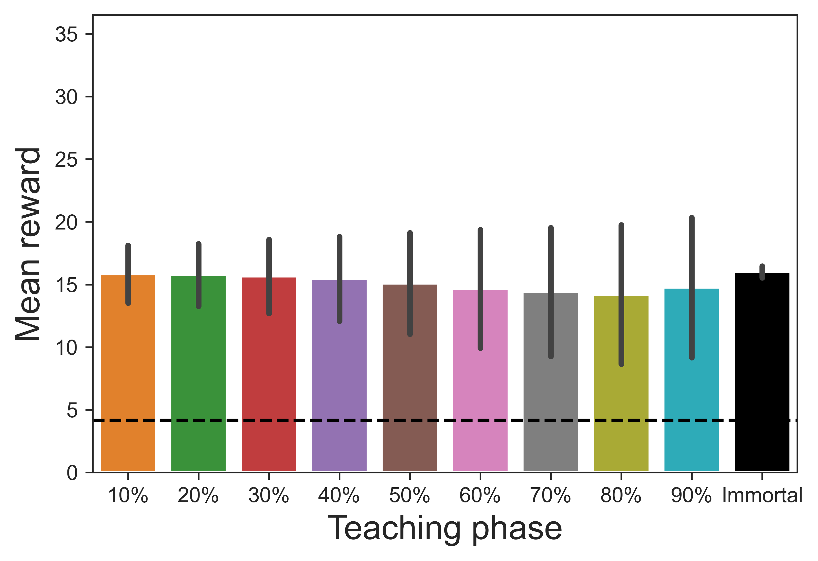
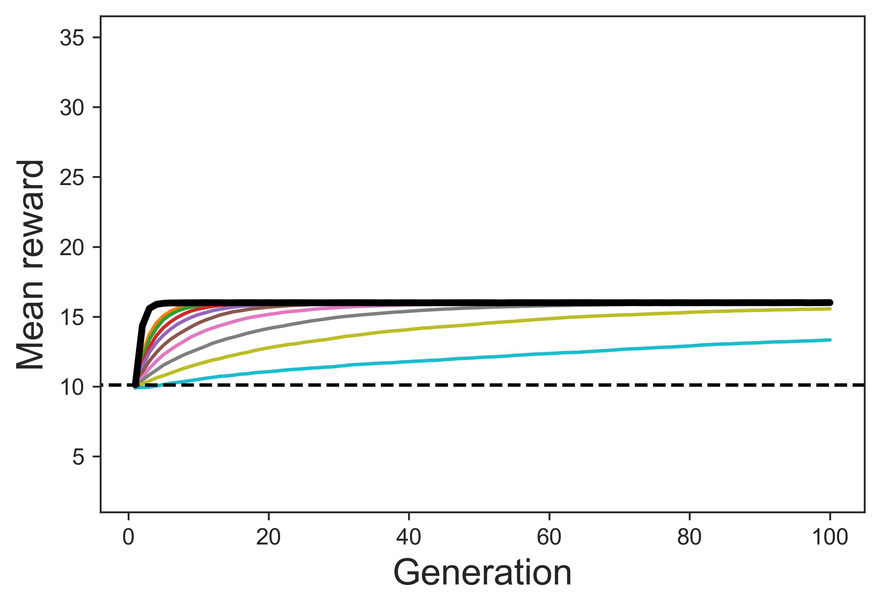
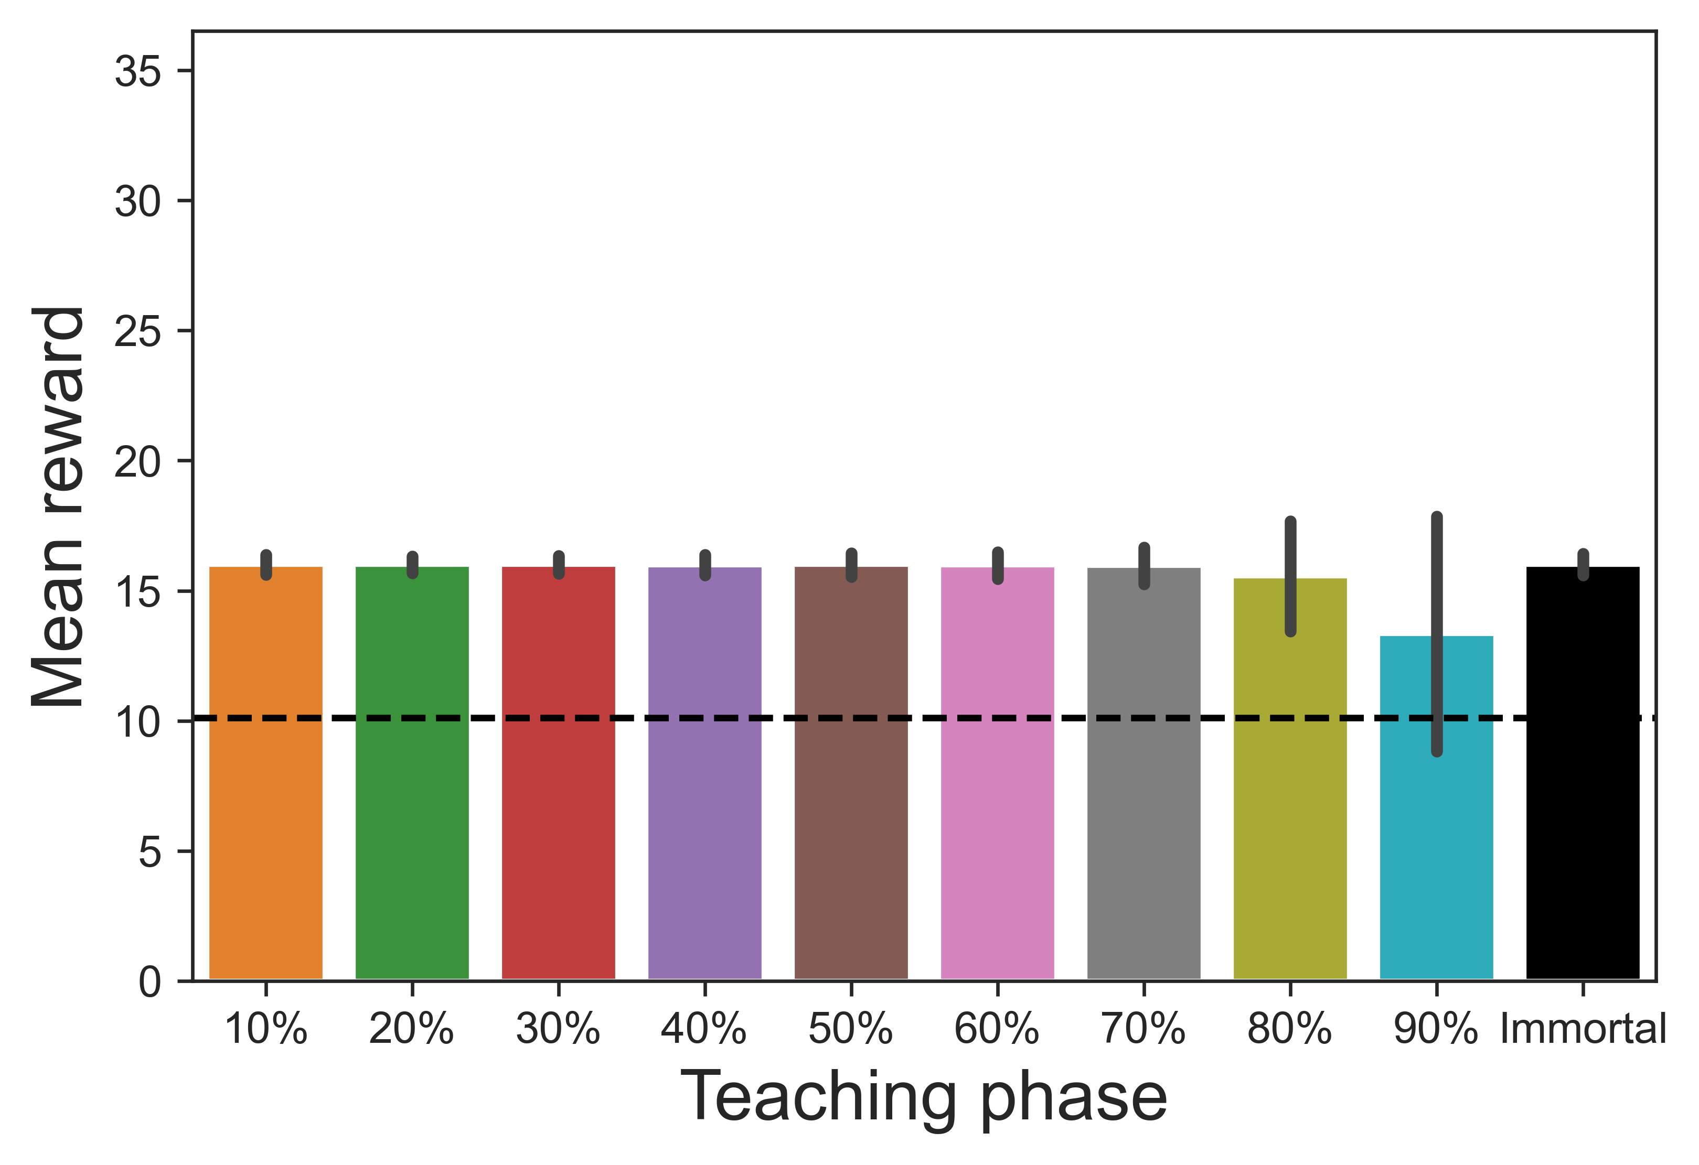
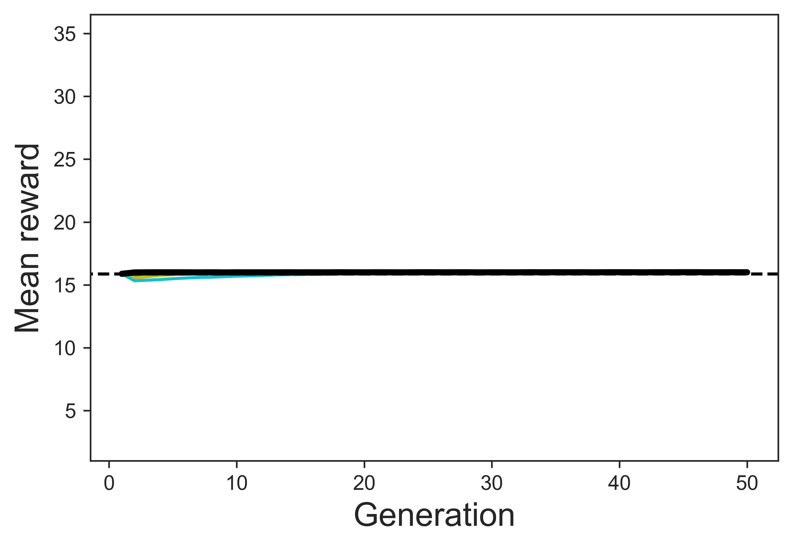
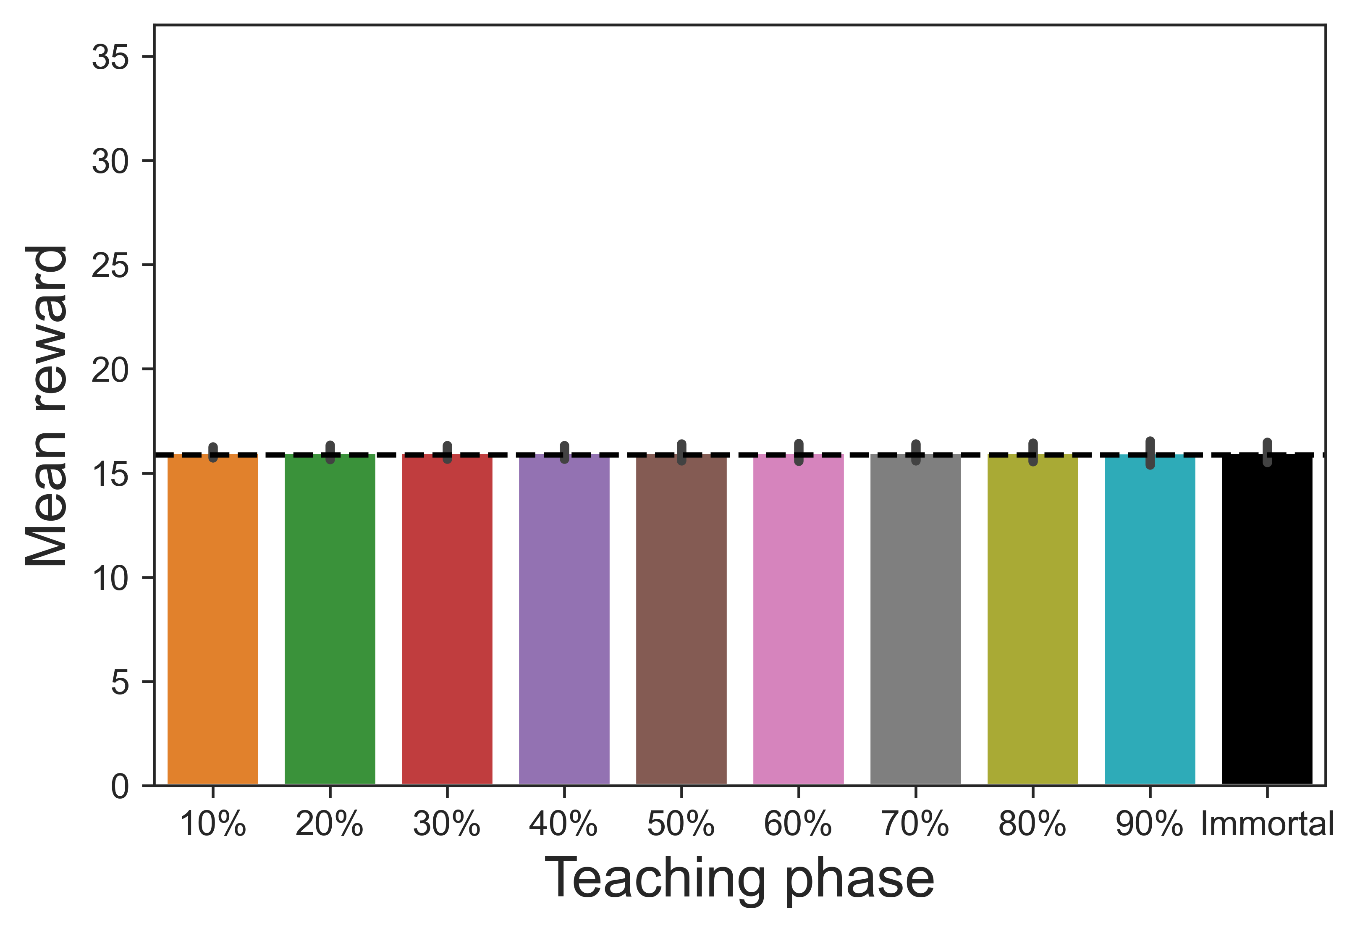
Mean reward in each generation
Mean reward in the last generation
R = 10, 7000th Generation
R = 10
R = 100, 2000th Generation
R = 100
R = 400, 1000th Generation
R = 400
R = 5000, 100th Generation
R = 5,000
R = 20000, 50th Generation
R = 20,000

